Slide 1
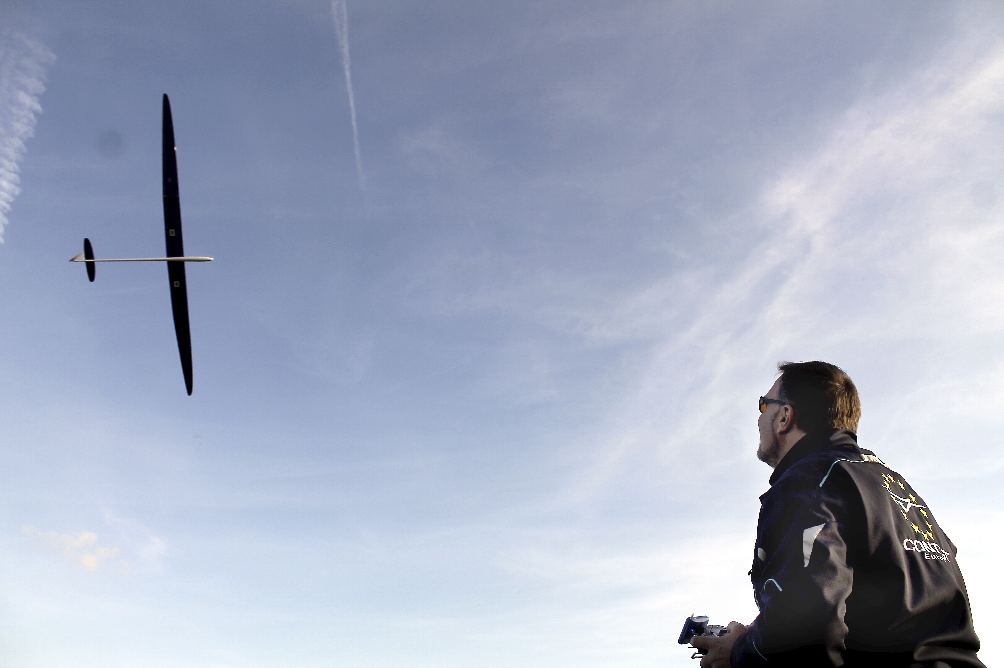
The basics of “MacCready flying”
© Philip Kolb
Slide number 01

Slide 2
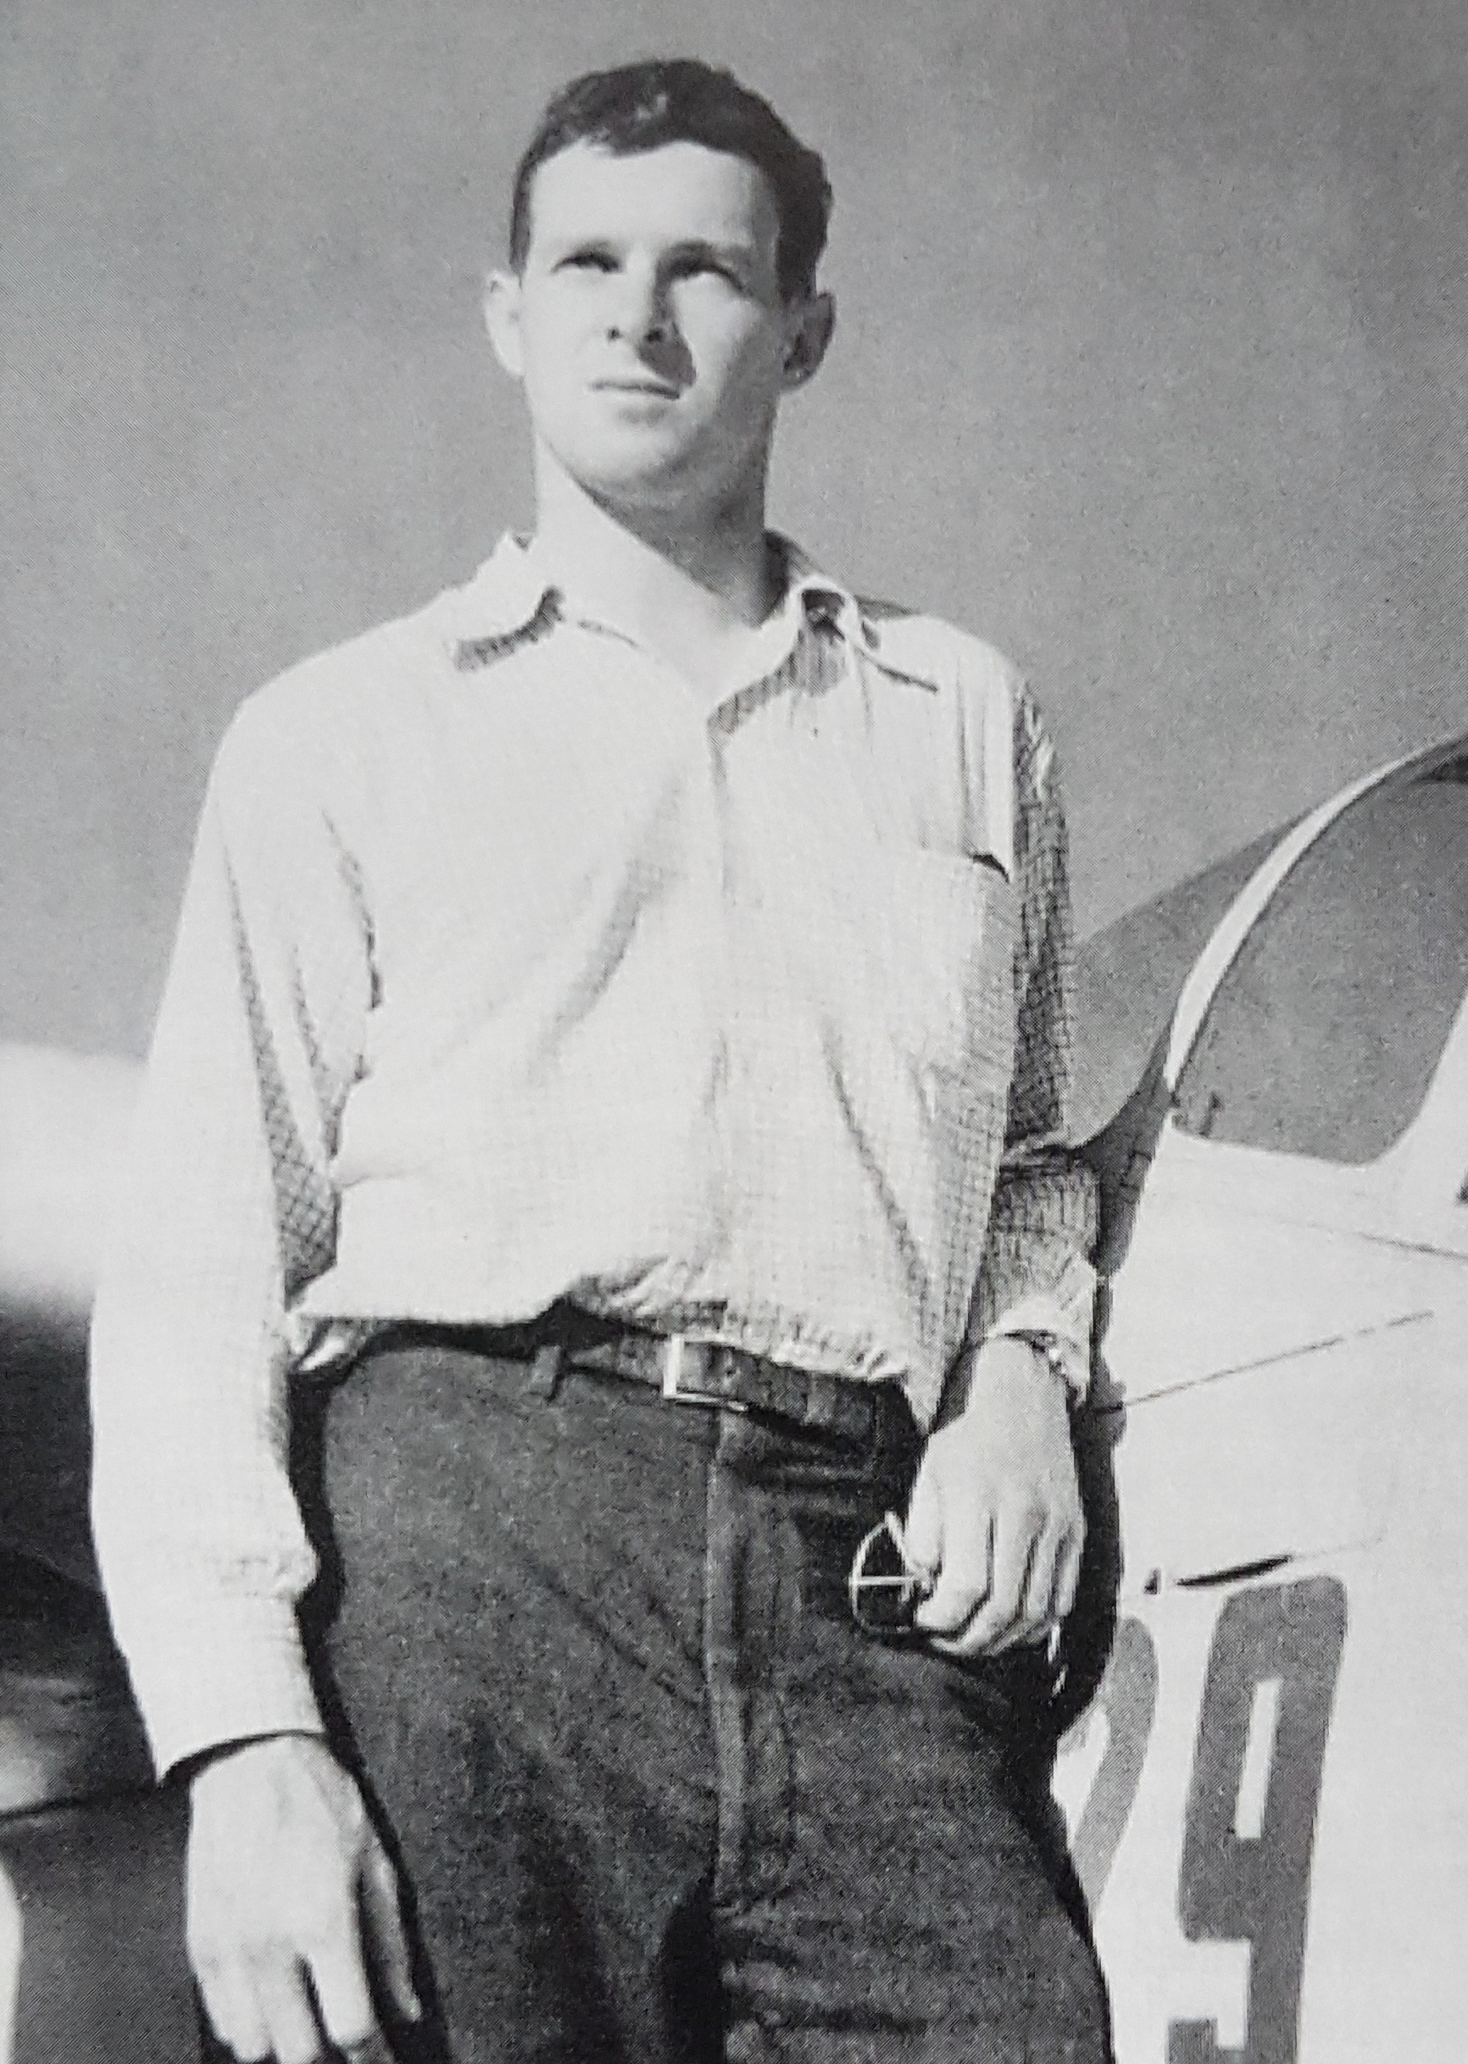
Paul B. MacCready (1925-2007)
© Philip Kolb
Slide number 02

Slide 3
Paul B. MacCready (September 25, 1925 – August 28, 2007)
was an American aeronautical engineer.
He was the founder of AeroVironment and devoted his life to developing more efficient transportation vehicles that could "do more with less".
With Dr. Peter B.S. Lissaman, he created a human-powered aircraft, the Gossamer Condor.
The Condor stayed aloft for seven minutes while it completed a figure eight course, thereby winning the first Kremer prize in August 1977.
The award winning plane was constructed of aluminum tubing, foam, piano wire, bicycle parts and mylar foil.
He later created solar-powered aircraft also, f.e. the Gossamer Penguin and Solar Challenger.
He was involved in the development of NASA's solar-powered flying wings such as the Helios, which surpassed the SR-71's altitude records and could theoretically fly on Mars (where the atmosphere is thin and has little oxygen).
But he also was a soaring pilot!!!
© Philip Kolb
Slide number 03

Slide 4
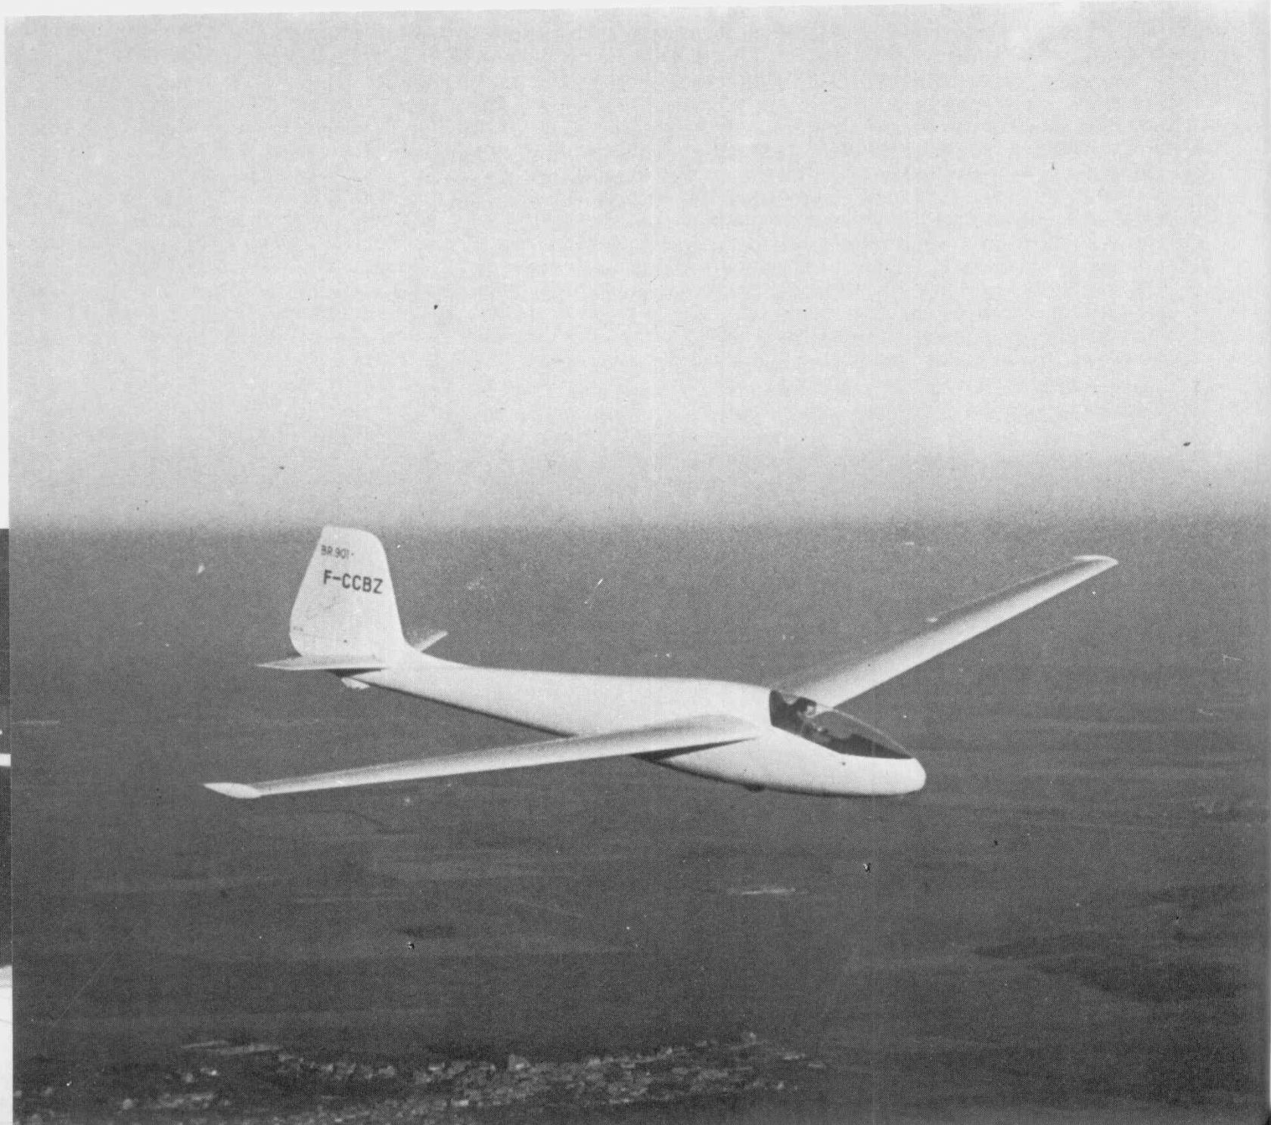
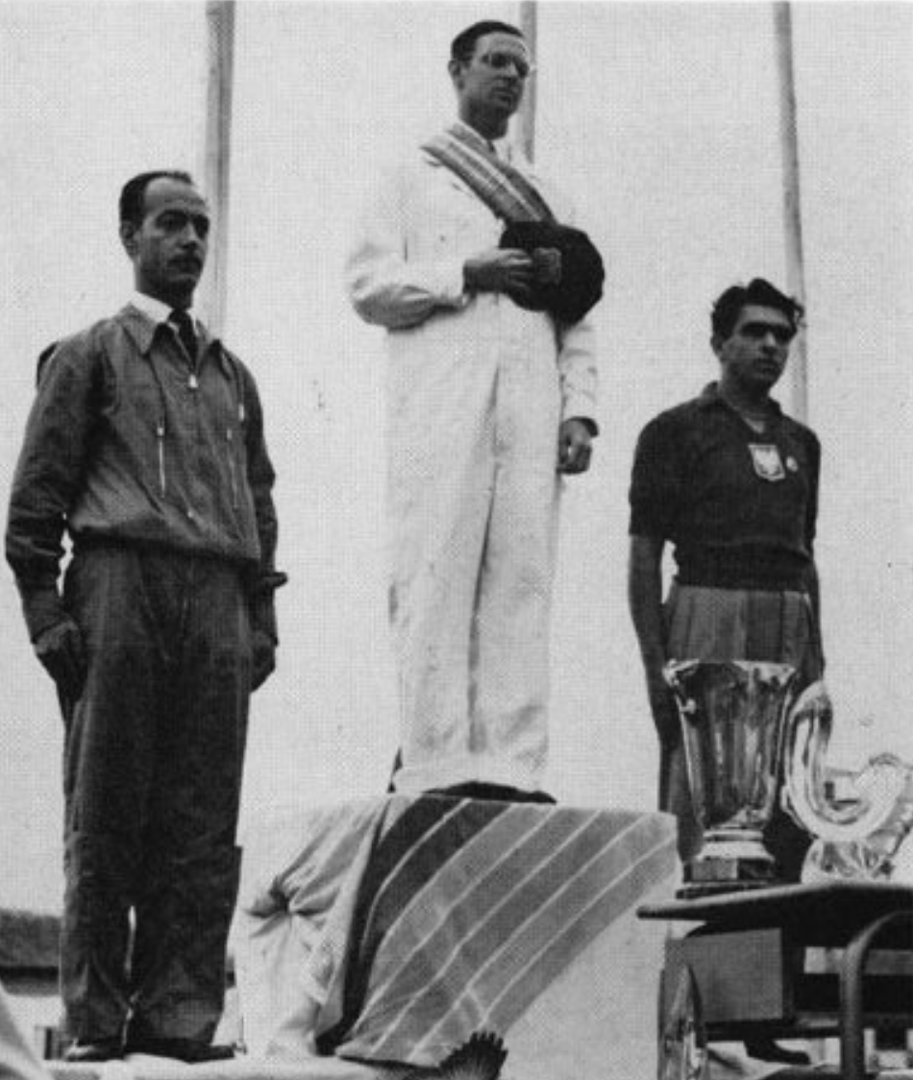
Paul B. MacCready (September 25, 1925 – August 28, 2007)
Paul MacCready was also a devoted glider pilot and won the U.S. National Open Class Soaring Championship 3 times (1948, 1949, 1953).
In 1956, he became the first American pilot to become the World Soaring Champion.
© Philip Kolb
Slide number 04

Slide 5
Paul B. MacCready (September 25, 1925 – August 28, 2007)
Since around 1947 MacCready was working on a way to select the optimum airspeed to maximize his “Cross Country Speed”.
To achieve this he was using the airplanes polar to calculate the “Speed to Fly”.
Paul Mac Cready therefore is renown as the "inventor" of the "Speed To Fly"-theory.
In essence, this theory is quite simple: → When the lift ahead promises to be strong you should fly faster.
→ When the lift ahead looks to be weaker, you should fly closer to your glider’s best L/D speed.
MC theory tells you exactly how fast you should fly based on the strength of lift you expect ahead.
© Philip Kolb
Slide number 05

Slide 6
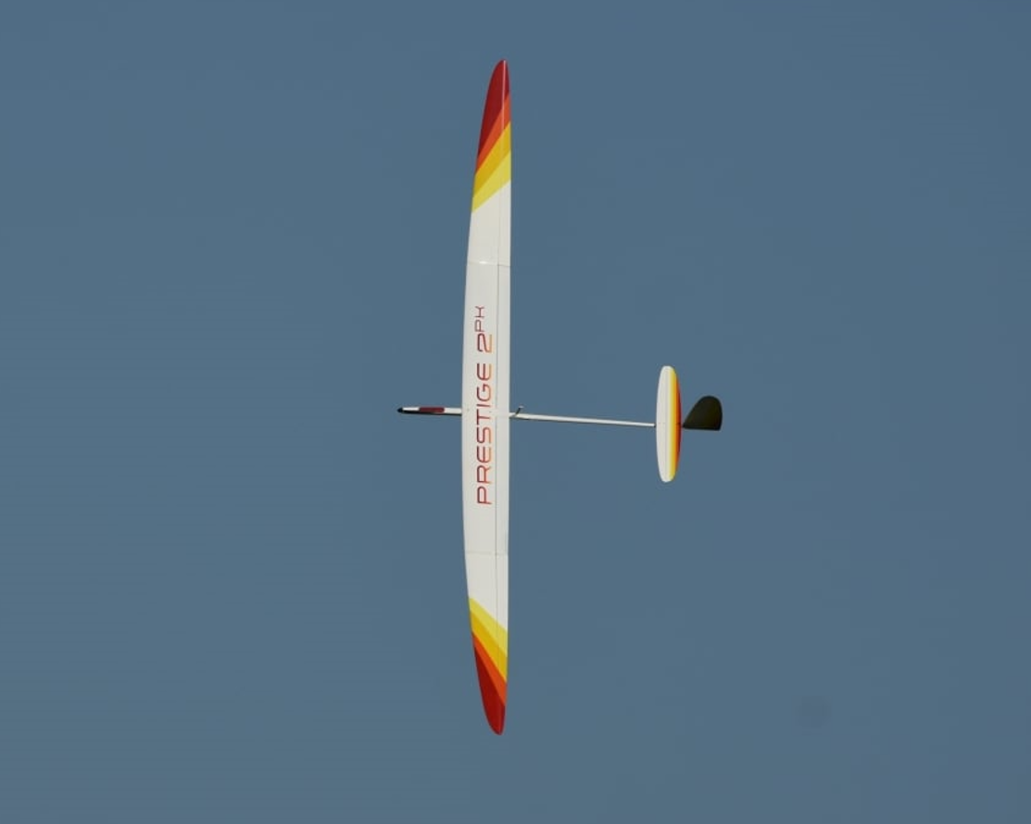
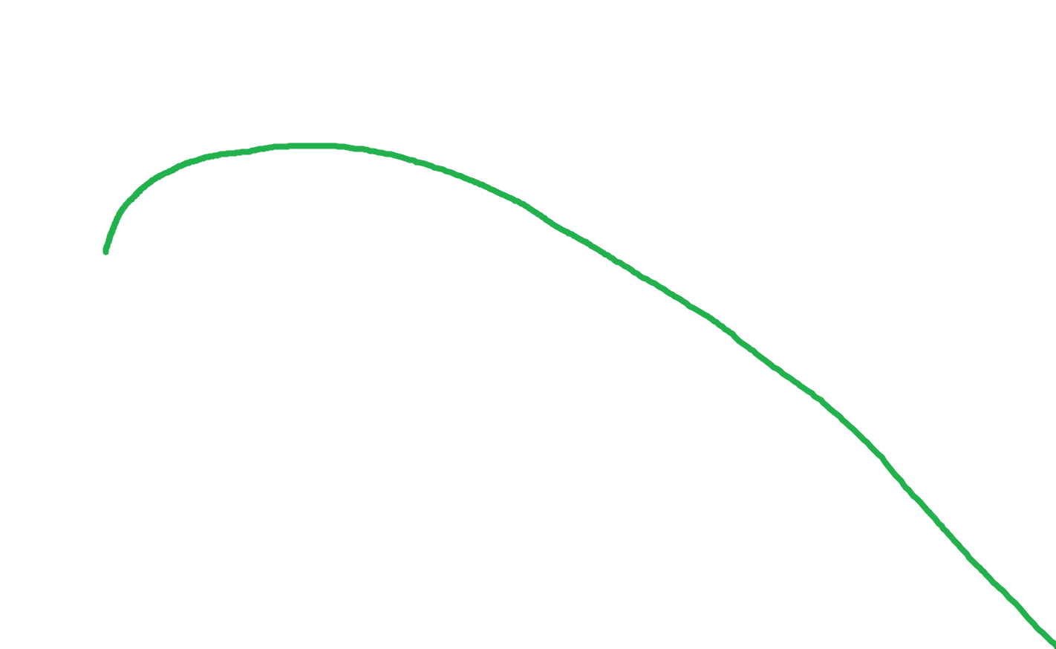
„The POLAR“
YES!!! We remember that!!!
© Philip Kolb
Slide number 06

Slide 7
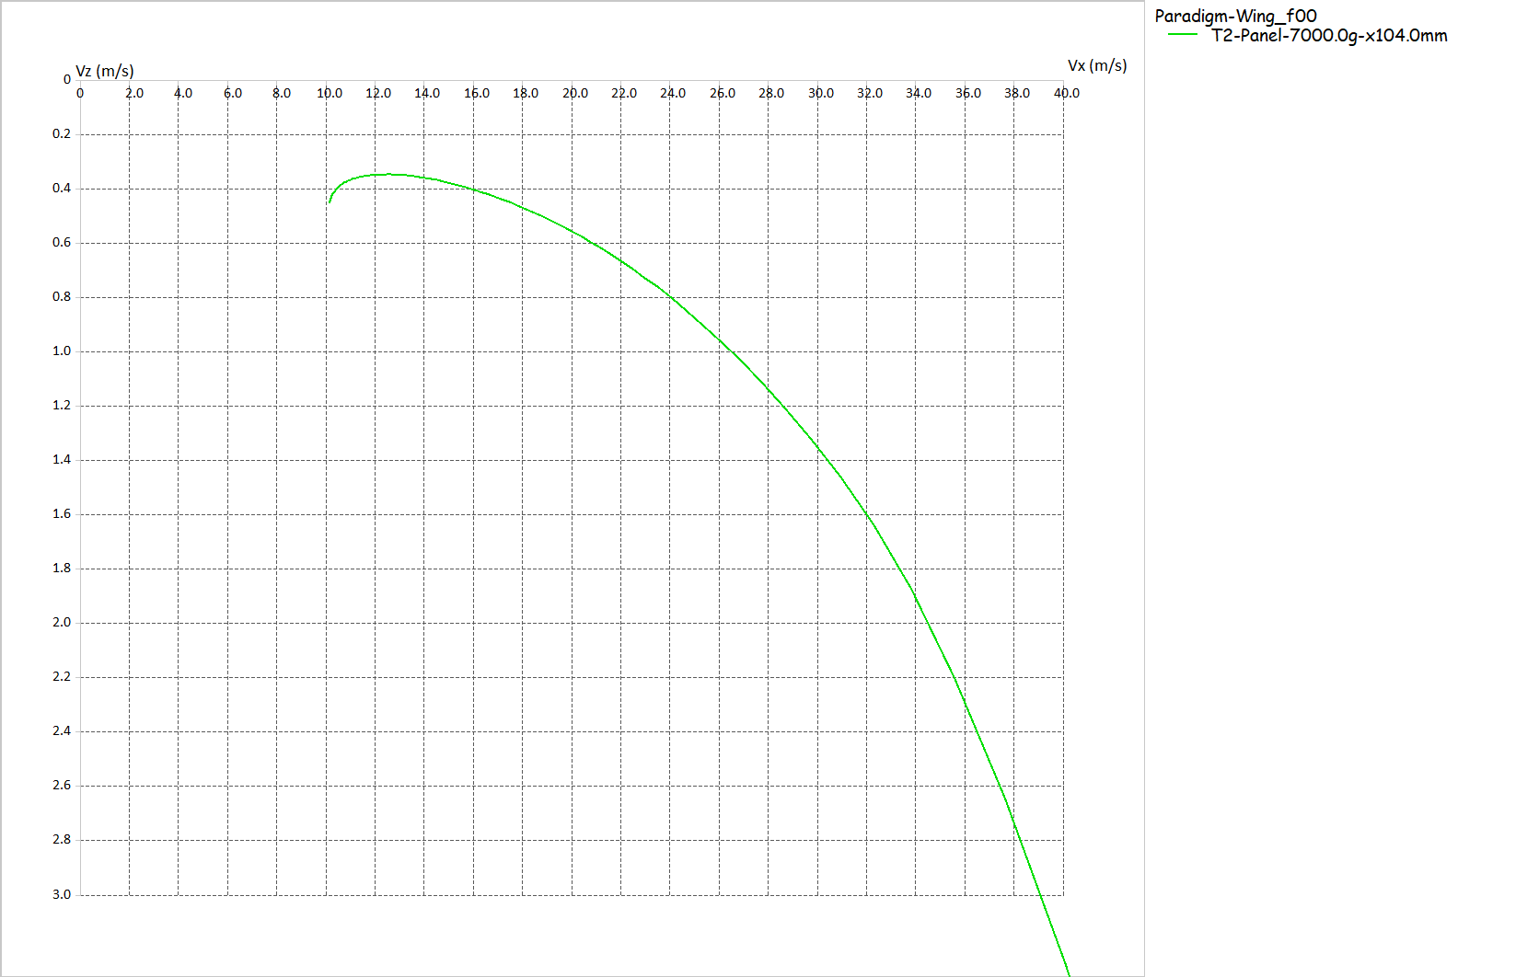
„Sink-Polar“ (Air Speed vs. Sink Speed)
And we remember that the tangent out of the point of origin “touching” the polar curve reflects the maximum L/D!
© Philip Kolb
Slide number 07

Slide 8
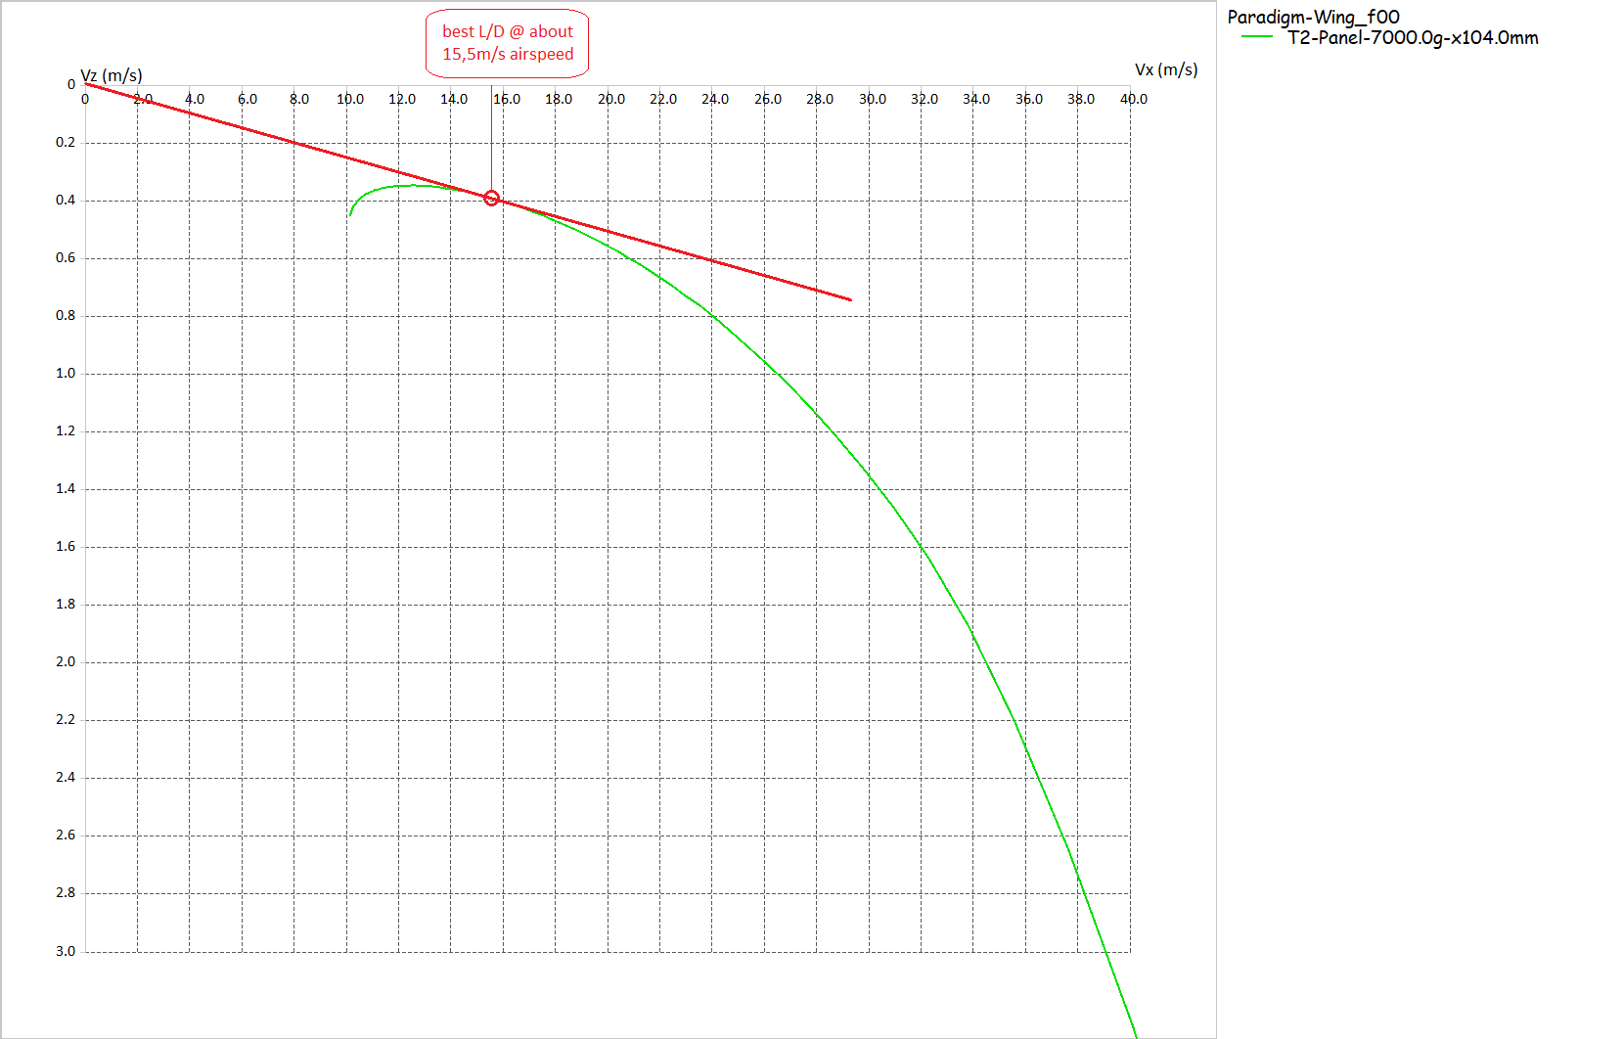
„Sink-Polar“ (Air Speed vs. Sink Speed)
As well as the “Speed to Fly” to achieve the maximum L/D.
© Philip Kolb
Slide number 08

Slide 9
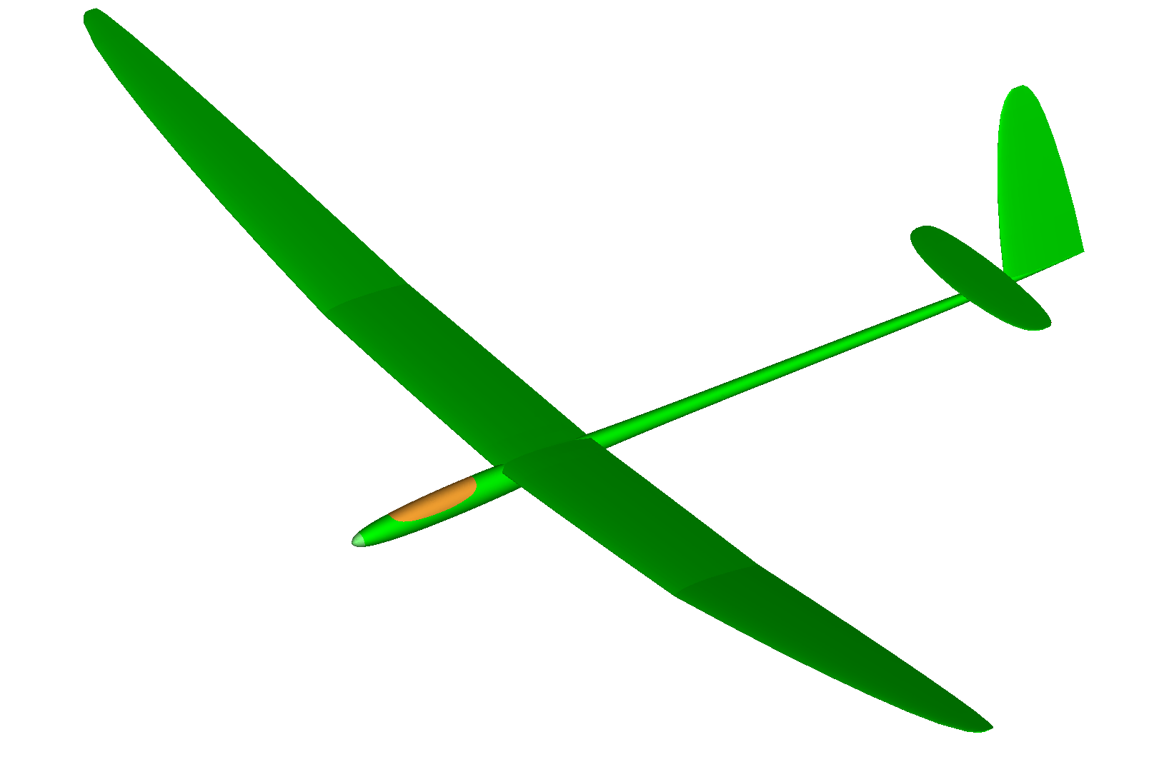
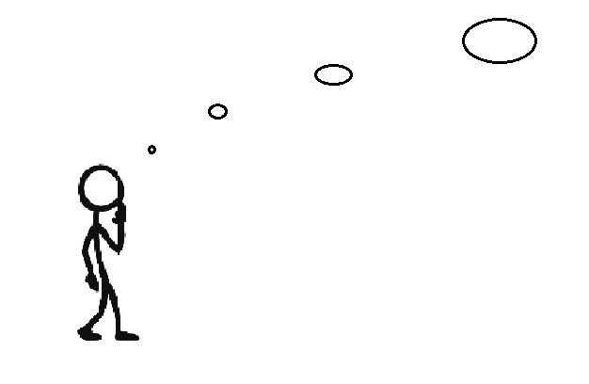
But only in “still” or “dead” air!!!
Ahhh!!!!
So the “Speed to Fly” for reaching the farthest possible distance,
is the speed indicated for the maximum L/D for my glider!
© Philip Kolb
Slide number 09

Slide 10
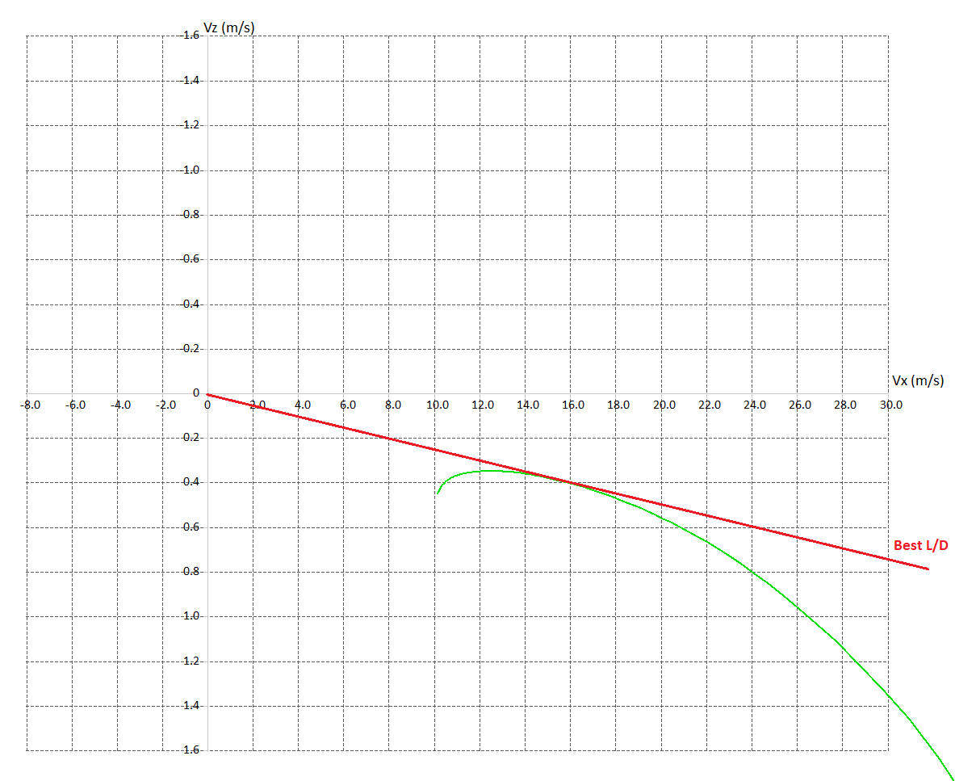
„Sink-Polar“ (Air Speed vs. Sink Speed)
In “still” or “dead” air we remember, that we can glide for about 39,74km
out of 1000m of altitude.
© Philip Kolb
Slide number 10

Slide 11
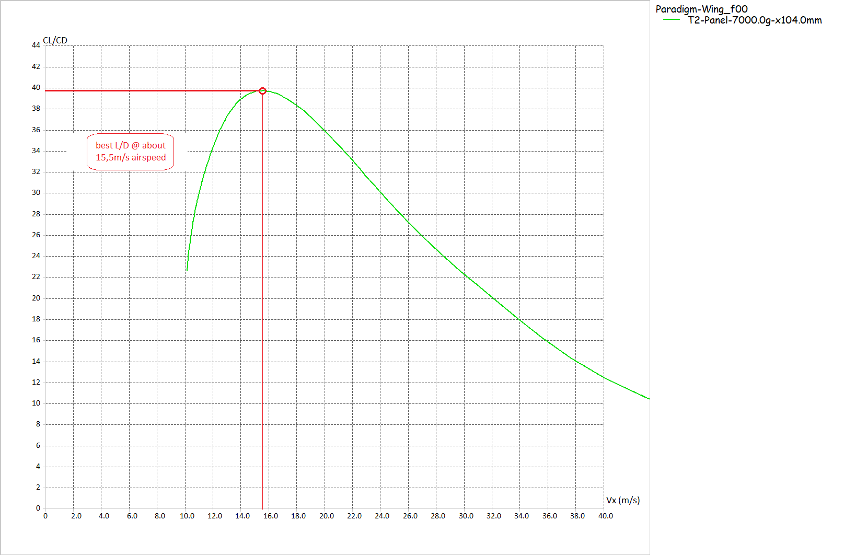
„Glide-Polar“ (L/D vs. Air Speed)
Maximum L/D about 39,74 @ 15,5m/s airspeed
In “still” or “dead” air we remember, that we can glide for about 39,74km
out of 1000m of altitude.
© Philip Kolb
Slide number 11

Slide 12
„Sink-Polar“ (Air Speed vs. Sink Speed)
In “still” or “dead” air we remember, that we can glide for about 39,74km
out of 1000m of altitude.
What would happen if we encounter a strong headwind? …let`s say 15,5m/s headwind???
How far could we go then?
© Philip Kolb
Slide number 12

Slide 13
„Glide-Polar“ (L/D vs. Air Speed)
Maximum L/D about 39,74 @ 15,5m/s airspeed
and 15,5m/s airspeed
@ 15,5m/s headwind
= 0 !!!
Both velocities cancel out and we would glide at best L/D “standing still” over the ground!
© Philip Kolb
Slide number 13

Slide 14
„Glide-Polar“ (L/D vs. Air Speed)
Maximum L/D about 39,74 @ 15,5m/s airspeed
To cover ground into a head wind, we need to push up the speed!!!
But this will come at a cost!
Our L/D is going down!
and 15,5m/s airspeed
@ 15,5m/s headwind
© Philip Kolb
Slide number 14

Slide 15
So to cover ground into a headwind, we need to push up the speed!
But by how much?
And what will be the best L/D at a given Headwind? What will be the necessary “Speed to Fly”?
© Philip Kolb
Slide number 15

Slide 16
„Sink-Polar“ (Air Speed vs. Sink Speed)
In “still” or “dead” air we remember, that we can glide for about 39,74km
out of 1000m of altitude.
Now we head into 7m/s wind
So we put the origin of our tangent in +7.0 on the X-Axis and touch the polar!
@ 18,8m/s airspeed
Best L/D for 7m/s headwind
© Philip Kolb
Slide number 16

Slide 17
„Sink-Polar“ (Air Speed vs. Sink Speed)
Groundspeed = 11,8m/s
Best L/D for 7m/s Headwind = 23,6
@ 18,8m/s airspeed
Sink speed = 0,5m/s
Best L/D for 7m/s headwind
© Philip Kolb
Slide number 17

Slide 18
„Sink-Polar“ (Air Speed vs. Sink Speed)
Ground speed = 11,1m/s
The maximum L/D at the “Speed to Fly” for 15,5m/s headwind is 11.1!
The “Speed to Fly” into a 15,5m/s headwind is 26.6m/s air speed!
Sink speed = 1m/s
© Philip Kolb
Slide number 18

Slide 19
Luckily there isn't always a headwind to fly into!
To find the best “Speed to Fly” for a tailwind situation works just the same!
© Philip Kolb
Slide number 19

Slide 20
„Sink-Polar“ (Air Speed vs. Sink Speed)
Let’s say we are flying down the course with a 7m/s tailwind!
In this case we will set the origin of the tangent touching our polar at “-7,0” on the X-Axis
Best L/D for 7m/s tailwind @13,5m/s airspeed
© Philip Kolb
Slide number 20

Slide 21
„Sink-Polar“ (Air Speed vs. Sink Speed)
Groundspeed = 20,5m/s
Best L/D for 7m/s tailwind @13,5m/s airspeed
Sink speed = 0,37m/s
The maximum L/D at the “Speed to Fly” for 7m/s tailwind is 55.4!
© Philip Kolb
Slide number 21

Slide 22
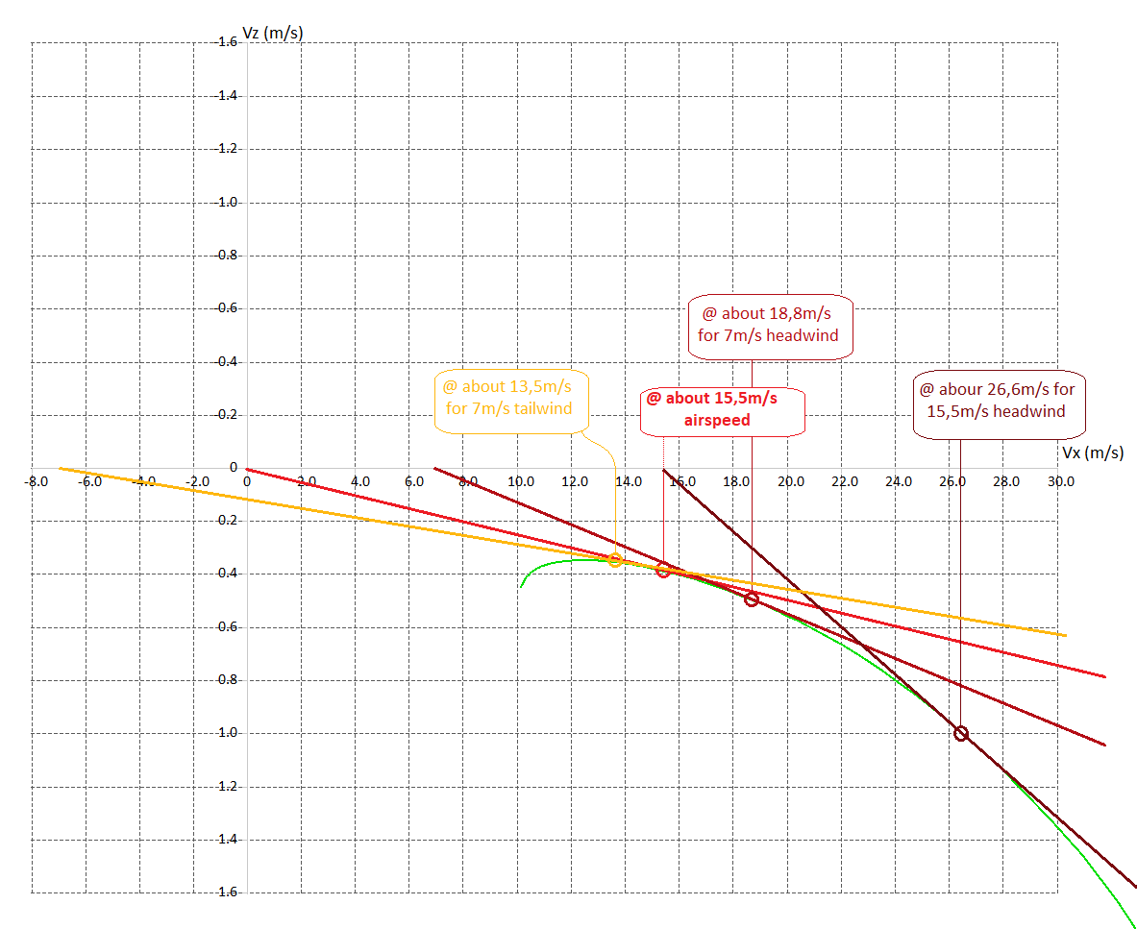
„Sink-Polar“ (Air Speed vs. Sink Speed)
Different “Speed to Fly” for different head- or tailwind components to achieve the best L/D for each scenario.
© Philip Kolb
Slide number 22

Slide 23
But we need to speed up the plane in a headwind situation! …for achieving the best possible L/D.
We can slow down the plane in a tailwind situation!
© Philip Kolb
Slide number 23

Slide 24
Now what would happen, if there’s not only wind but Thermals?
Updrafts
and
Sink
© Philip Kolb
Slide number 24

Slide 25
„Sink-Polar“ (Air Speed vs. Sink Speed)
In the case of vertical movements of the air – like thermals and sink – the vertical axis (Y-Axis) get’s important!
© Philip Kolb
Slide number 25

Slide 26
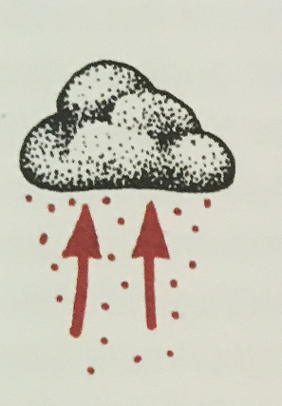
„Sink-Polar“ (Air Speed vs. Sink Speed)
In this special case the tangent touching the polar is parallel to the X-Axis.
The velocity of the rising air mass cancels out the sink rate of the aircraft and thus we could fly on and on …and on…and on….
How fast to fly, when we encounter a soft (weak) thermal? Let’s say it just offers 0,33m/s climb rate…
Best L/D @ 12.7m/s
air speed
L/D = ∞
© Philip Kolb
Slide number 26

Slide 27
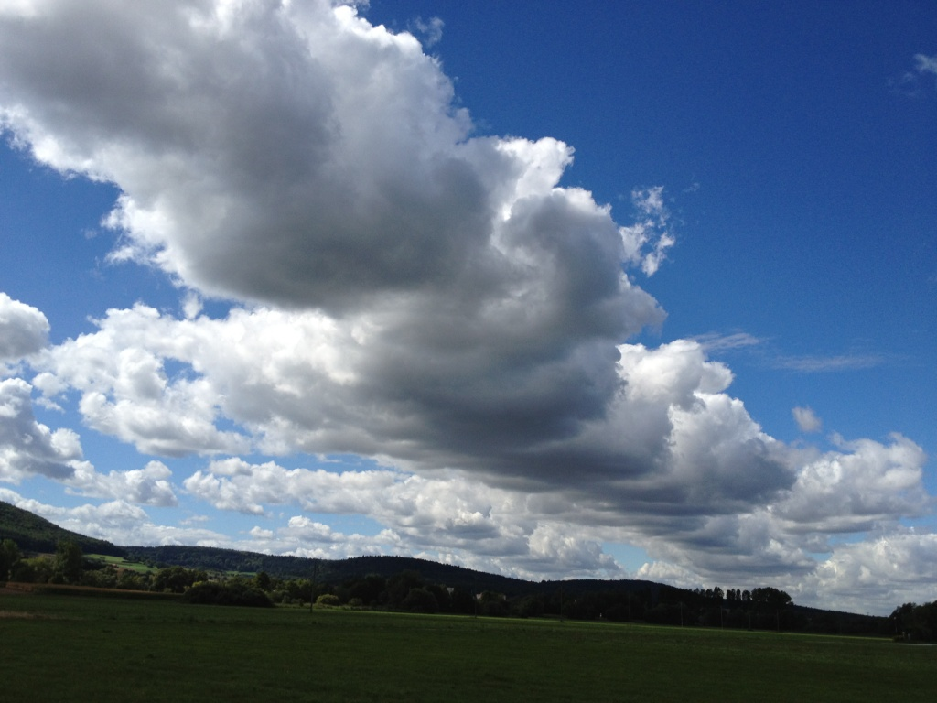
As this is a very theoretical but unrealistic scenario. Let’s see what speed we need to fly when encountering sink
f.e. after thermaling in lift.
© Philip Kolb
Slide number 27

Slide 28
„Sink-Polar“ (Air Speed vs. Sink Speed)
After leaving the thermal we encounter 1,6m/s sink.
Best L/D for 1,6m/s sink. “Speed to Fly” = 28,0 m/s air speed!
© Philip Kolb
Slide number 28

Slide 29
„Sink-Polar“ (Air Speed vs. Sink Speed)
Groundspeed = 28m/s
No matter what! We´re gonna push through that nasty sink!!!
Sink speed = - 2,72m/s
….even if it will be at the cost of a best possible L/D of 10.3!
Sink rate of the air mass (= -1,6m/s)
and the sink rate of the aircraft (-1,12m/s)
add up!
© Philip Kolb
Slide number 29

Slide 30
We can`t help it! We need to push through the sink. …for achieving the best possible L/D.
We can slow down the plane if we fly straight line through a thermal!
© Philip Kolb
Slide number 30

Slide 31
„Sink-Polar“ (Air Speed vs. Sink Speed)
For understanding the “Speed to Fly” criteria, we need an understanding of the polar of our glider and the air mass we are flying through!
Best L/D = 8,6 for 6m/s headwind and 1,5m/s sink “Speed to Fly” = 30m/s
Best L/D = 25,5 for 7m/s tailwind and 0,5m/s sink “Speed to Fly” = 17,2m/s
Best L/D = 115 for 2m/s headwind and 0,25m/s climb “Speed to Fly” = 13m/s
Best L/D = - 37,2 ( “-”!!!) for 4m/s tailwind and 1,4m/s climb “Speed to Fly” = 10,5m/s
This reflects a very special case where “dolphin-style” flying could be chosen. If the conditions hold up, our aircraft can climb the most and fly the farthest at the same time. In this case climb 1000m while covering 37,2km distance.
© Philip Kolb
Slide number 31

Slide 32
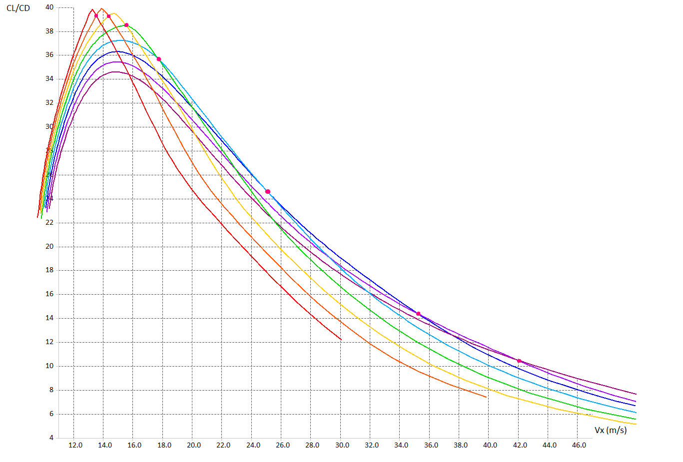
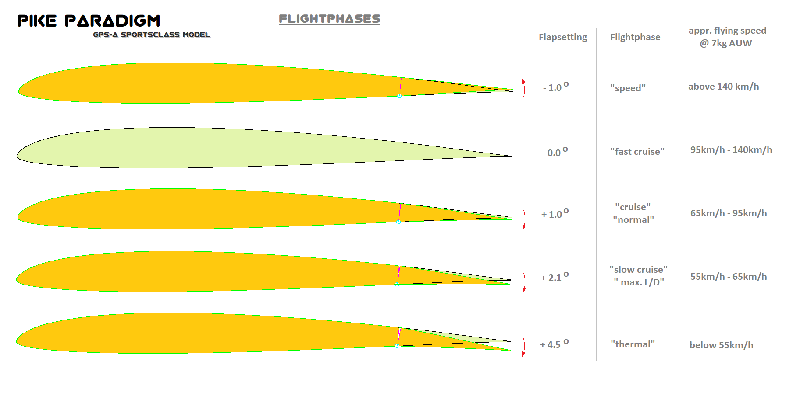
Camber / Reflex setup as a possible way to tweak our planes´ performance!
We remember this!!!
© Philip Kolb
Slide number 32

Slide 33
© Philip Kolb
Slide number 33

Slide 34
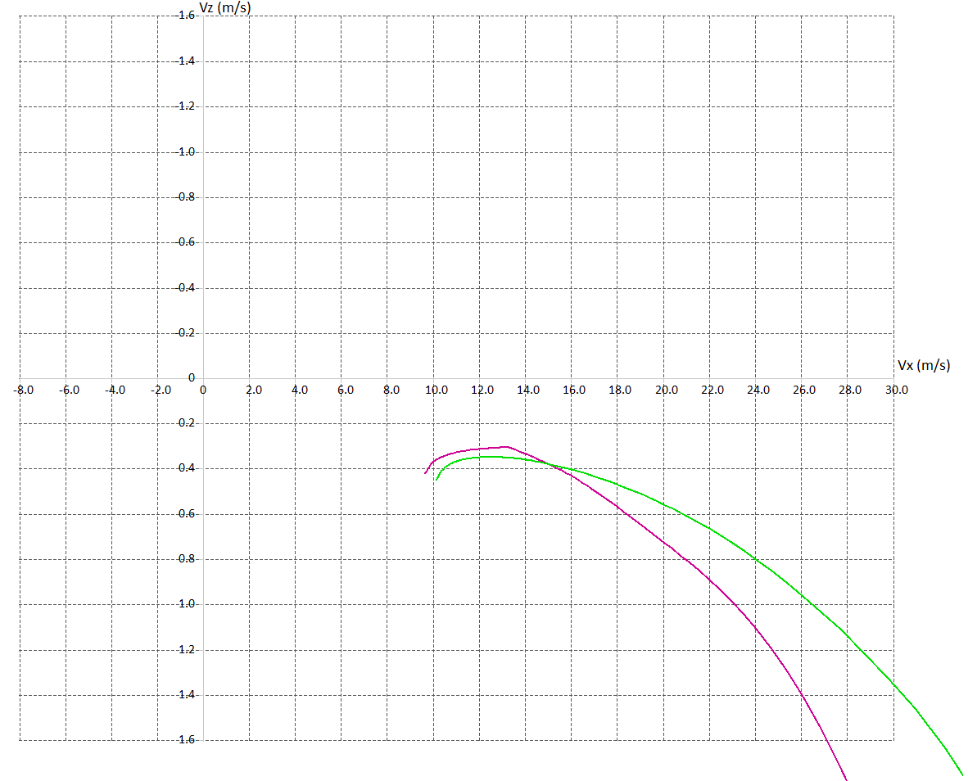
„Sink-Polar“ (Air Speed vs. Sink Speed)
Adapting our aircrafts configuration in accordance to the necessary “Speed to Fly”
Best L/D = 155 for 2m/s headwind and 0,25m/s climb “Speed to Fly” = 12,7m/s
Polar for f = 0 degrees
Best L/D = 115 for 2m/s headwind and 0,25m/s climb “Speed to Fly” = 13m/s
Polar for f = +5 degrees
© Philip Kolb
Slide number 34

Slide 35
Now we know the basics of MacCready-Flying.
And yes….. We need to know about our planes’ polar!
The more accurate this knowledge is,
the better we can adapt our flying.
Nevertheless… It is better to understand this concept first, than knowing the exact numbers.
Because this knowledge
- and as well some flight testing – can lead us towards making the right Assumptions!
© Philip Kolb
Slide number 35

Slide 36
Assumptions
That’s what the Classic MacCready Theory is based upon: Assumptions
made out of
knowledge and experience!
What would you assume for your flight tactics when looking at this
“cloud-street”?
© Philip Kolb
Slide number 36

Slide 37
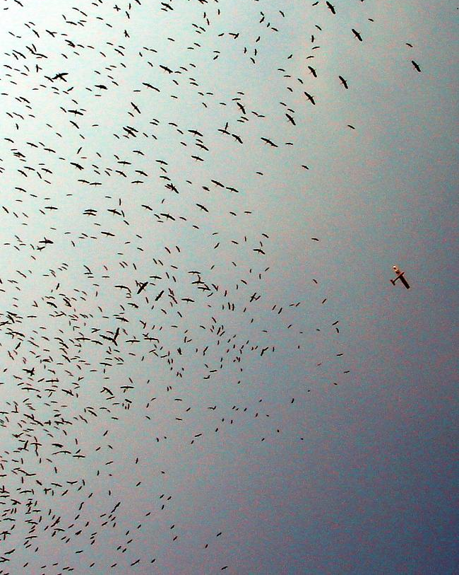
If we can make the right assumptions,
the concept of the “Speed to fly” theory can not only get us fly longer distances, it also can get us to cover ground faster!
© Philip Kolb
Slide number 37

Slide 38
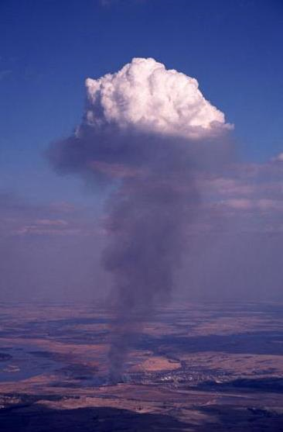
It is all about the best possible educated guess (assumption) of the thermal strength of:
The next thermal ahead
The next thermals ahead
The thermals (ahead) in general
Is it
…???
3m/s
2m/s
What would we do with
that information?
1m/s
What if someone could tell us
the strength of that thermal?
© Philip Kolb
Slide number 38

Slide 39
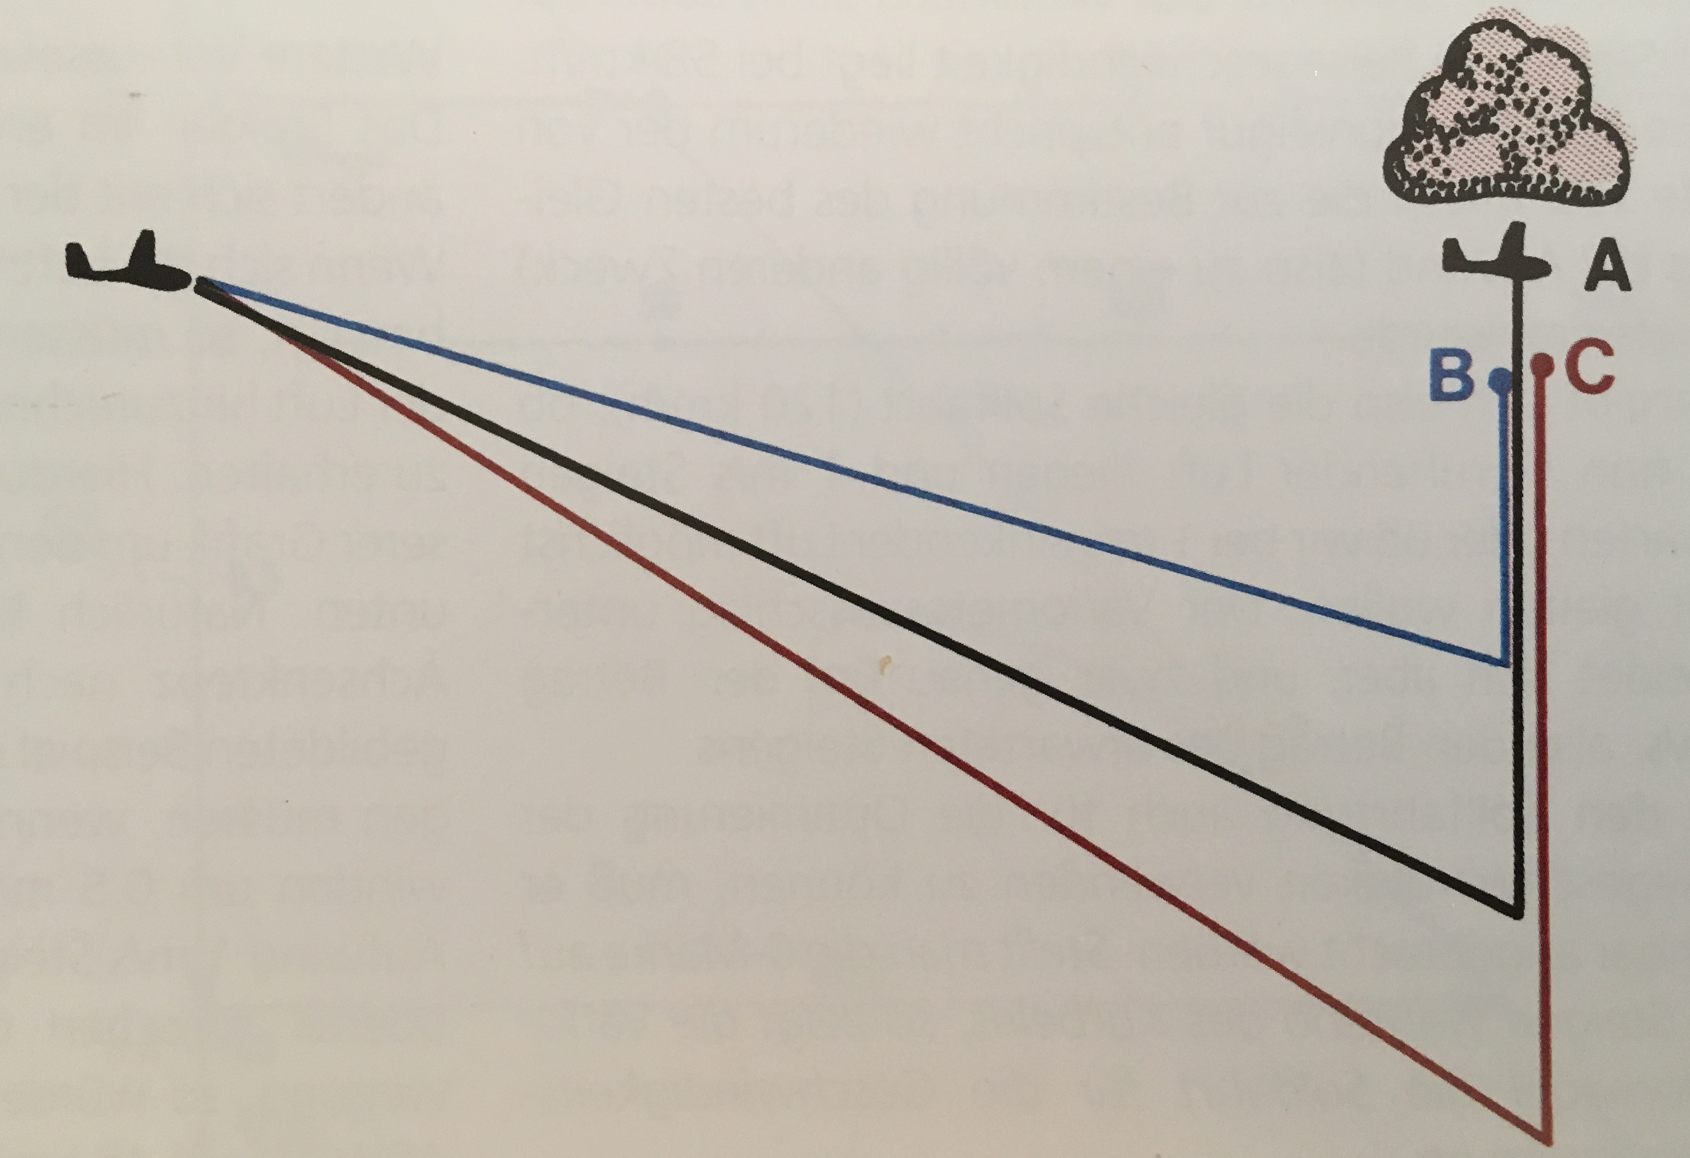
Let’s say the thermal ahead offers a 2m/s average climb in reality.
Pilot B is careful. He assumes the thermal ahead offers 1m/s climb. He is not pushing very hard and takes a lot of time to reach the thermal. He reaches it in good altitude – but late.
2m/s
Pilot C is aggressive. He assumes the thermal ahead offers 3m/s climb. He is pushing very hard and takes a lot of risk “driving almost into the ground”.
He is the first to reaches it – but low…and needs to spend a lot of time climbing back up!
© Philip Kolb
Slide number 39

Slide 40
Let’s say the thermal ahead offers a 2m/s average climb in reality.
Pilot A chooses the right “Speed to Fly”. He assumes the thermal ahead offers 2m/s climb. He reaches it in reasonable altitude and can climb his way back to resume flying on course first. He will gain valuable speed over the other two pilots.
2m/s
© Philip Kolb
Slide number 40

Slide 41
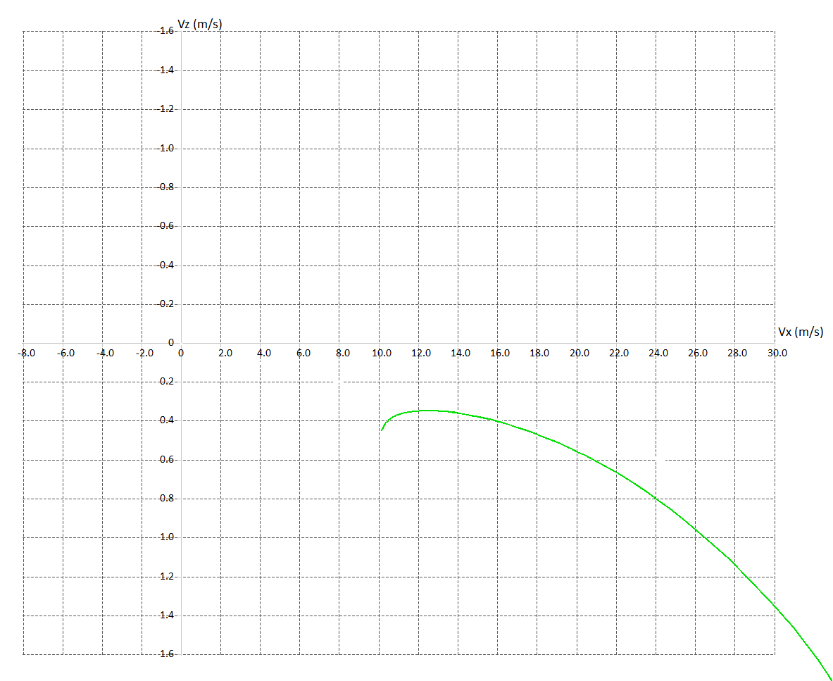
„Sink-Polar“ (Air Speed vs. Sink Speed)
If we assume the next thermal(s) will offer 1,5m/s climb rate…
… we need to push forward in between thermals with the same
“Speed to Fly” as if we would push through 1,5m/s sink!
26,4m/s
© Philip Kolb
Slide number 41

Slide 42
„Sink-Polar“ (Air Speed vs. Sink Speed)
If our assumptions are right,
We can reach the next thermal(s) and the air in between thermal(s) is “calm”,
our effective average cross country speed will be…
We can read it out at the intersection, where our tangent is crossing the X-Axis.
16,7m/s
26,4m/s
© Philip Kolb
Slide number 42

Slide 43
This is actually what the “classic” MacCready-theory is about.
It is about assuming and calculating the best “Speed to Fly” to predict the best possible cross country speed.
© Philip Kolb
Slide number 43

Slide 44
Teaching us to make assumptions about the weather conditions and thermal strength.
And it works for us as well!
Knowing about the basic principles of performance polars.
Avoiding mistakes.
Knowing when to take risks and when to be careful.
Supporting our tactical approach.
© Philip Kolb
Slide number 44

Slide 45
Pilot B is reaching a much higher average speed!
© Philip Kolb
Slide number 45

Slide 46
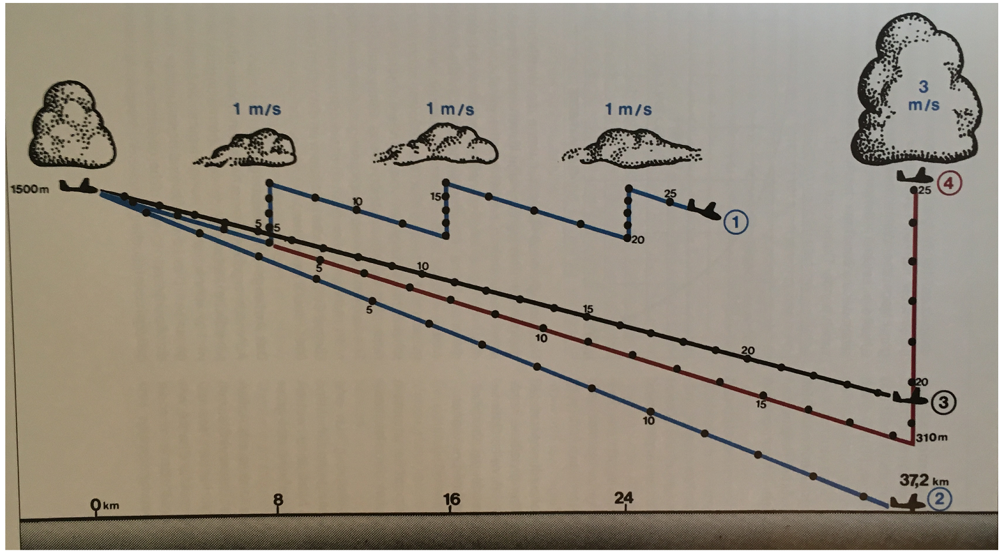
A final example of making good use of the MacCready-theory
© Philip Kolb
Slide number 46

Slide 47
Summary and “lessons learned”
What of all this can we take to the field?
Know the limitations of the model you apply!
Precise assuming and setting of the MacCready values is not extremely important! Just try and avoid huge mistakes!
Conservative MacCready flying increase your chances of finding (better) lift!
Aggressive MacCready flying can win you a round! But can also increase the chance of landing way too early!
Fly conservative and careful when getting low. Choose not to push too hard and choose also weaker thermals to stay airborne.
Fly aggressive and push up the speed when you are high. Don’t circle in weak lift, take only the strong thermals!
Apply the laws and rules about basic MacCready flying and learn from it. Sharpen your perceptıons while applying it to be able to make better and better assumptions!
What else?
© Philip Kolb
Slide number 47

Slide 48
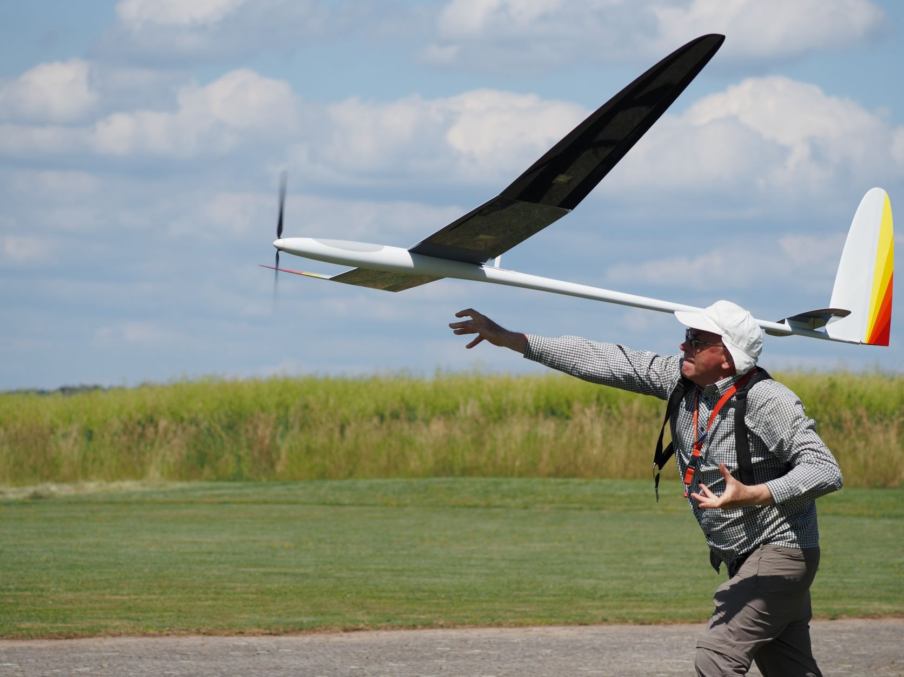
Enough for now!!!
Thank you for your attention!
Let this sink in.
Any Questions?
© Philip Kolb
Slide number 48

