Slide 1
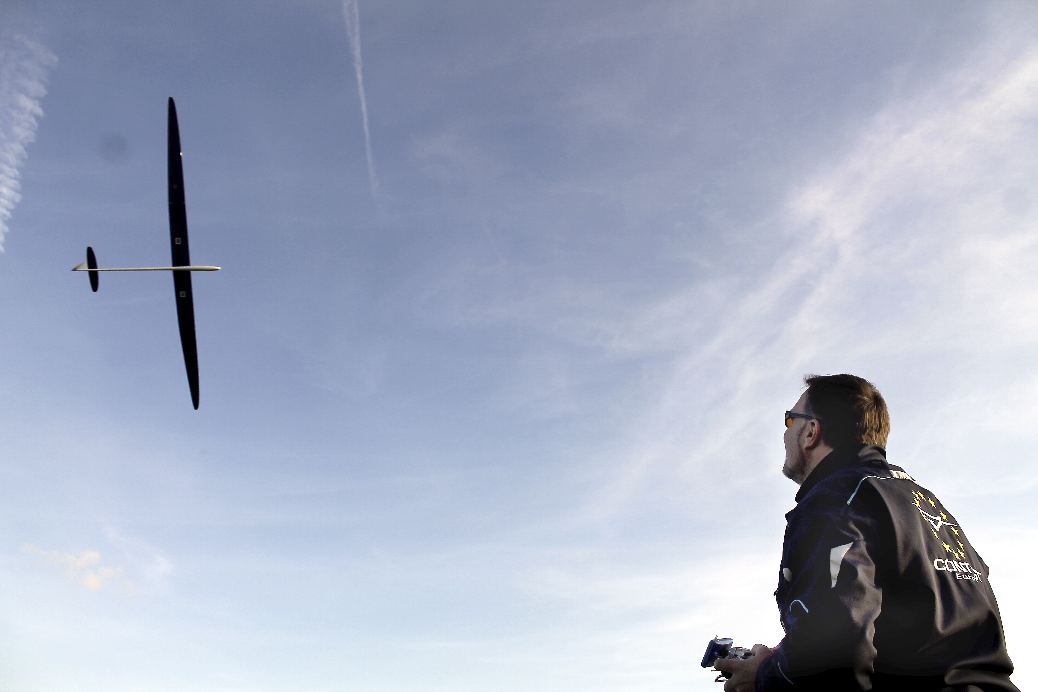
A little bit about model glider performance
© Philip Kolb
Slide number 01

Slide 2
What is „performance“?
“This glider has an amazing performance!”
“This glider handles great!!!”
Handling-Parameters (flight mechanics) like:
Directional stability
Spiral stability
High “agility” (throw authority, low inertia)
“control harmony"
Performance-Parameters like:
Maximum L/D (lift-to-drag-ratio)
Wide range of high L/D´s
Minimum sink
Difference!
Note: A glider which “handles nice and easy”, gives us the possibility to get the maximum performance out of it!
© Philip Kolb
Slide number 02

Slide 3
Let´s take a look and understand “performance”:
How can we describe the “performance” of our model gliders?
How can we compare the “performance” of our model gliders?
How can we get “performance” out of our gliders?
How can we tweak our models “performance”?
How can we avoid mistakes by knowing about our gliders performance?
© Philip Kolb
Slide number 03

Slide 4
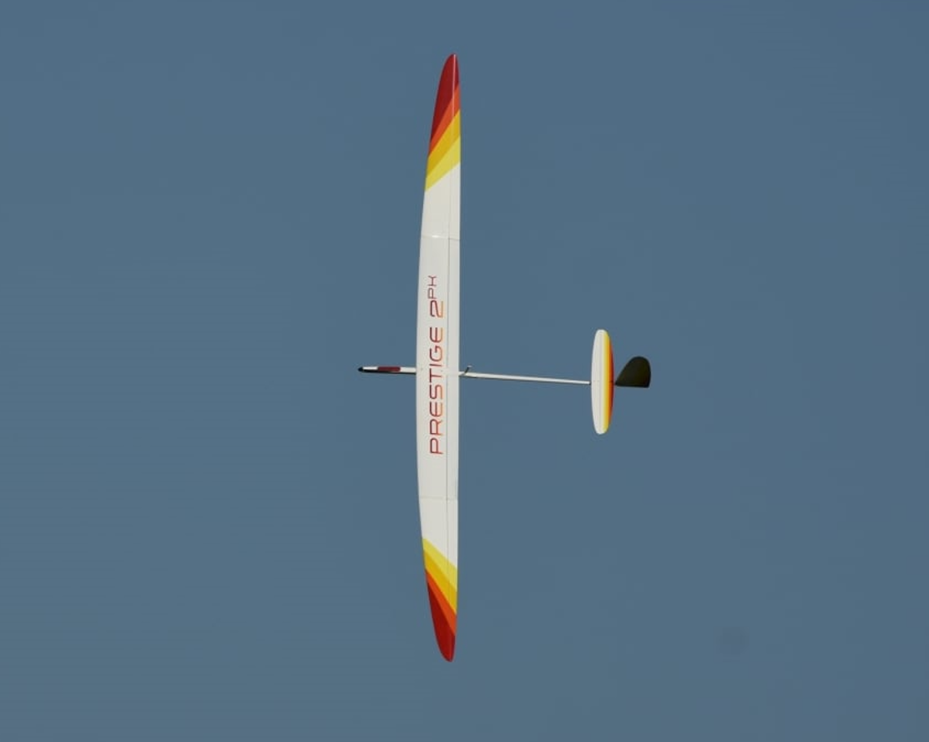
„The POLAR“
© Philip Kolb
Slide number 04

Slide 5
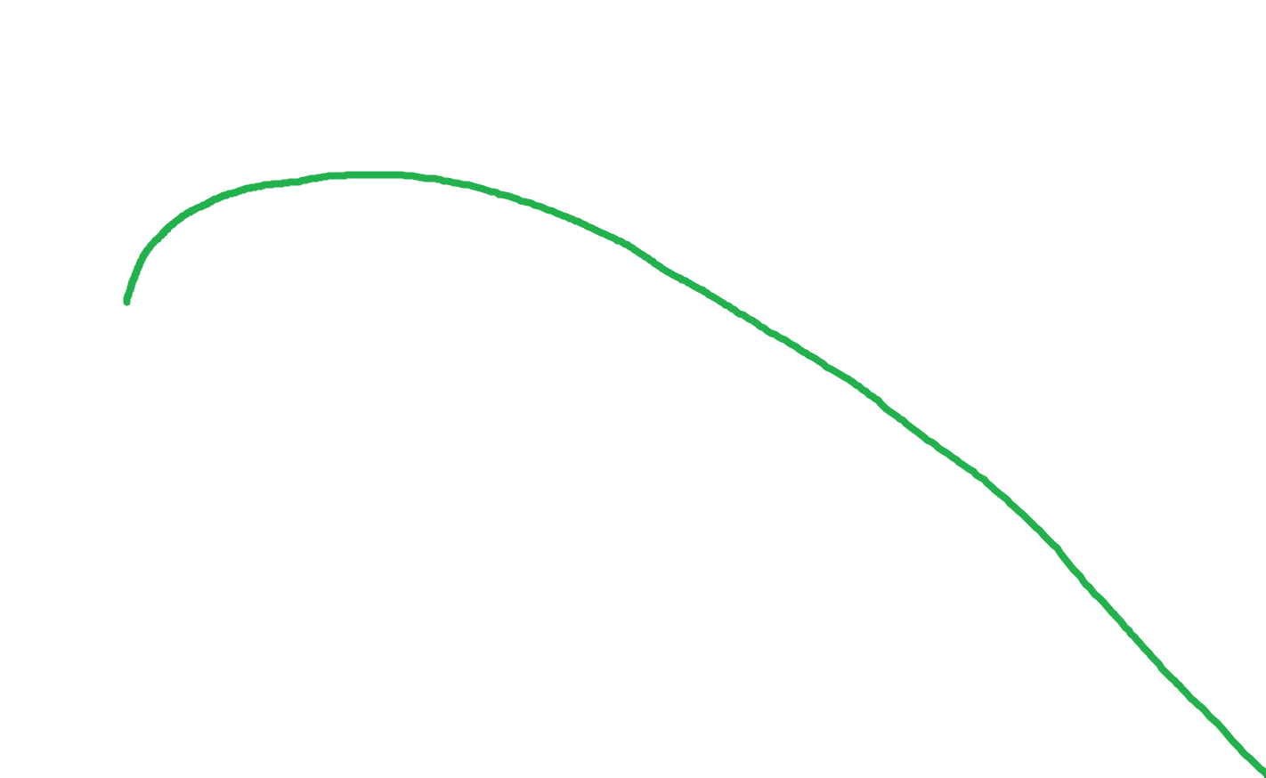
„Sink-Polar“ (Air Speed vs. Sink Speed)
☺ That is what it`s all about!!! ☺
© Philip Kolb
Slide number 05

Slide 6
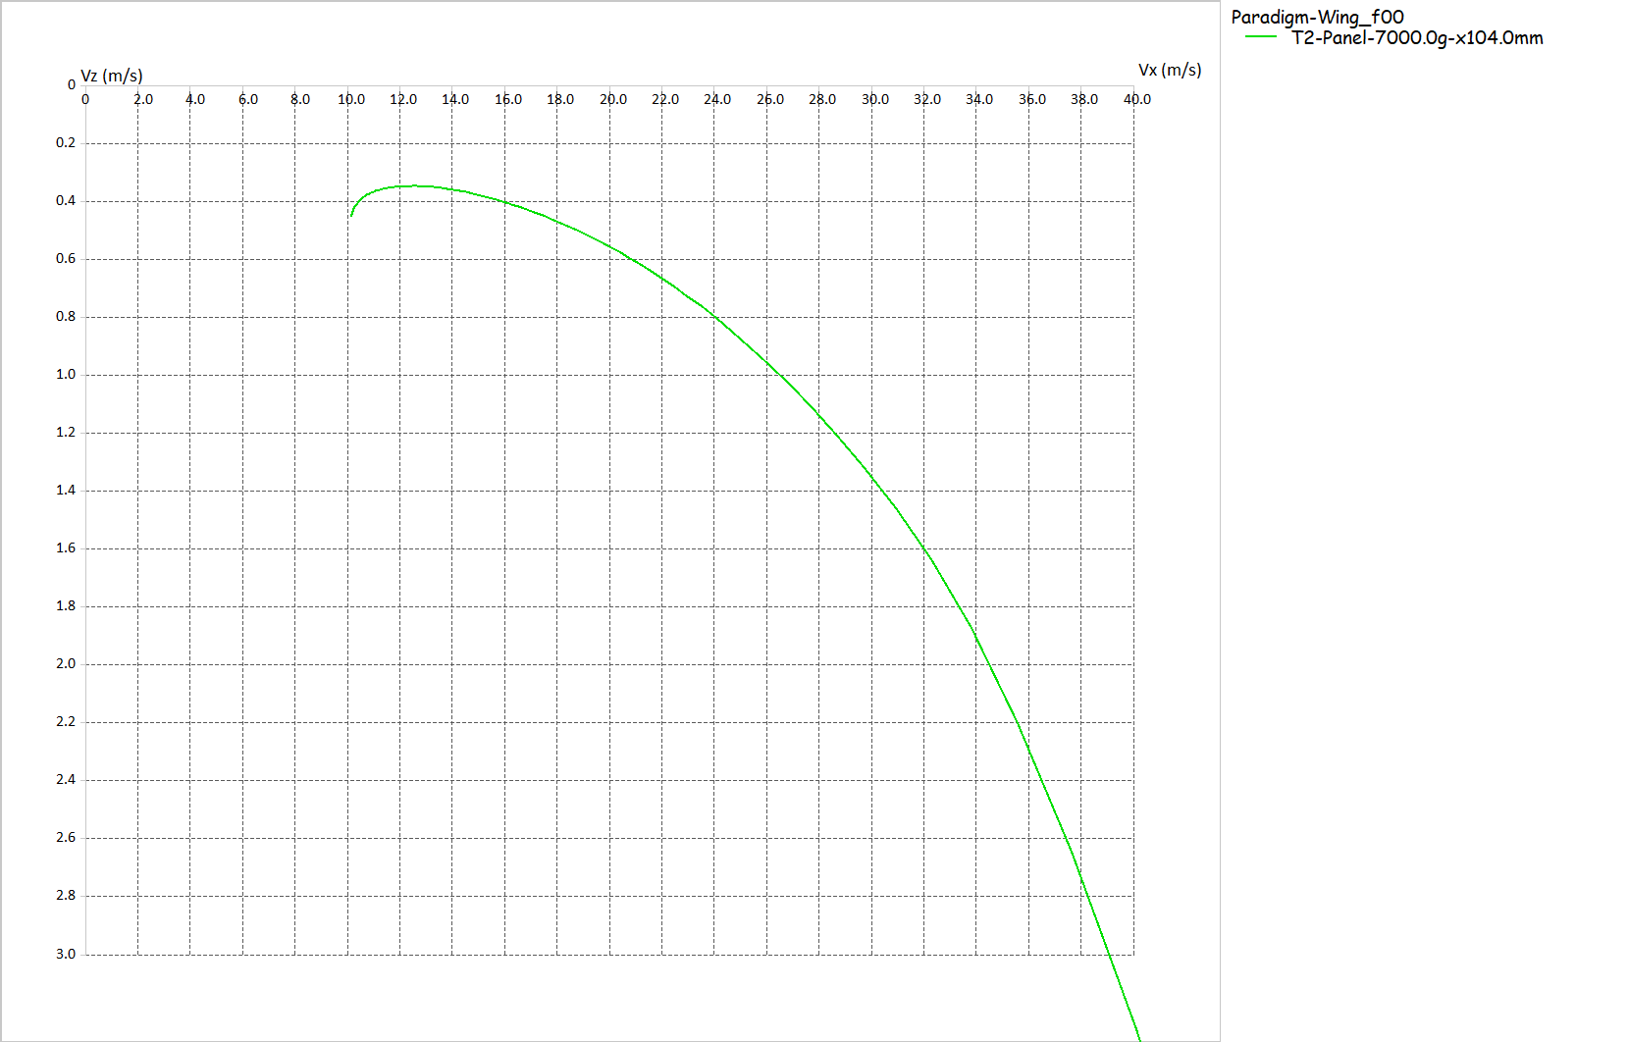
„Sink-Polar“ (Air Speed vs. Sink Speed)
© Philip Kolb
Slide number 06

Slide 7
„Sink-Polar“ (Air Speed vs. Sink Speed)
The tangent out of the point of origin “touching” the polar curve reflects the maximum glide ratio!
© Philip Kolb
Slide number 07

Slide 8
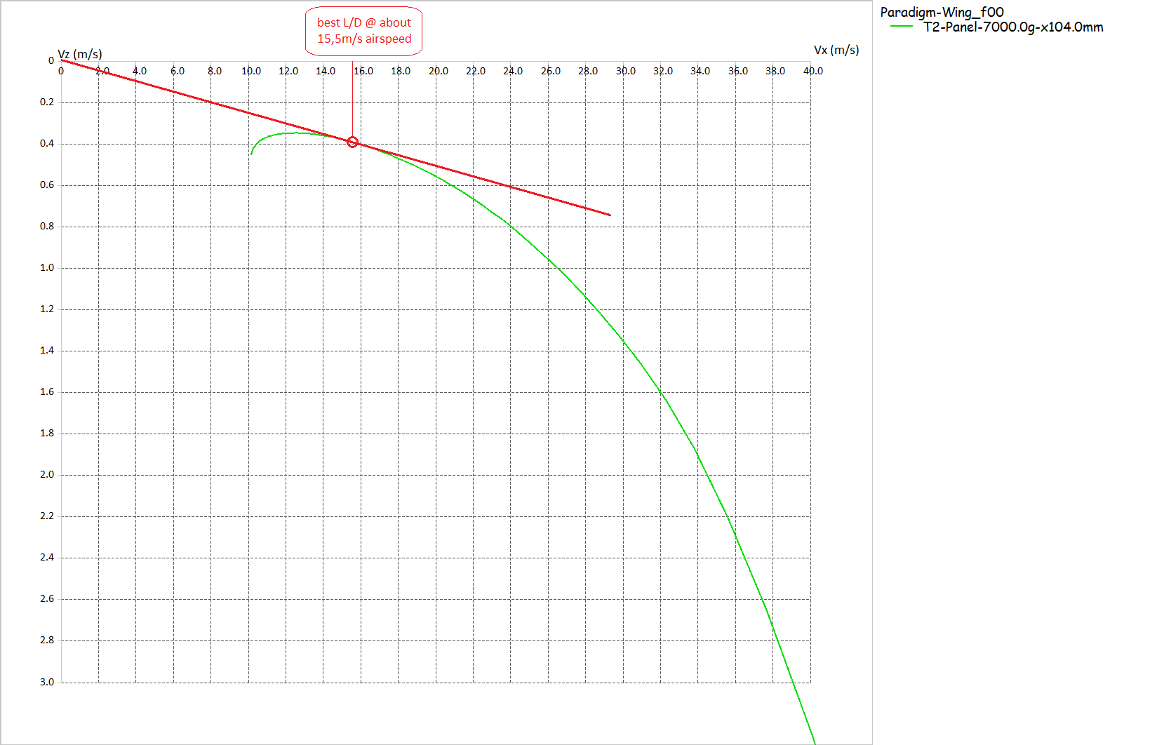
„Sink-Polar“ (Air Speed vs. Sink Speed)
“Glide ratio” describes the ratio between Lift and Drag proportions on our aircraft.
→ Lift over Drag
→ Lift / Drag
→ L / D
In the case shown, the tangent touches the polar curve at an air speed of 15,5m/s. This reflects a sink speed of 0,39m/s.
Thus the maximum L/D ratio here is: 15,5m/s : 0,39m/s = 39,74
© Philip Kolb
Slide number 08

Slide 9
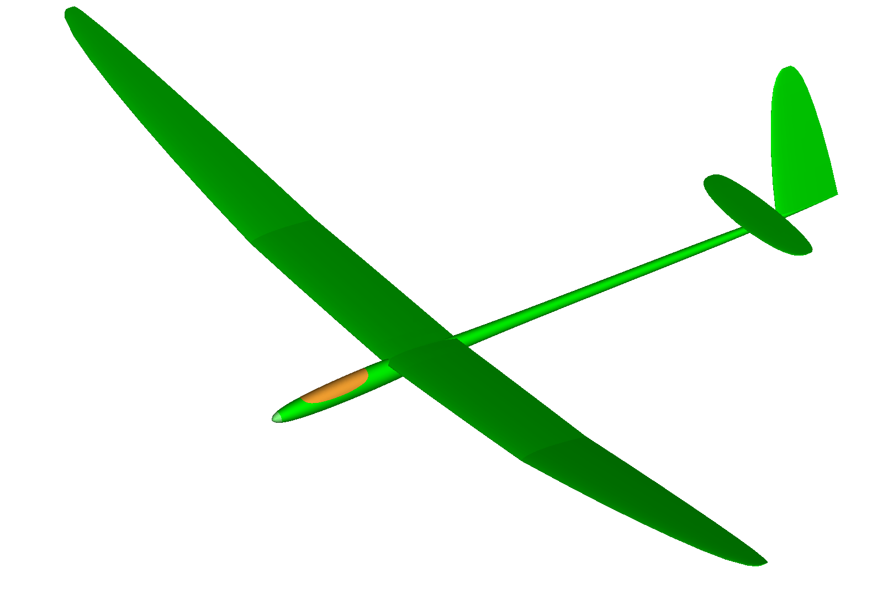
Is there any other way to depict this?
Of course! Calculate a curve of all L/D-values over the air speed!
© Philip Kolb
Slide number 09

Slide 10
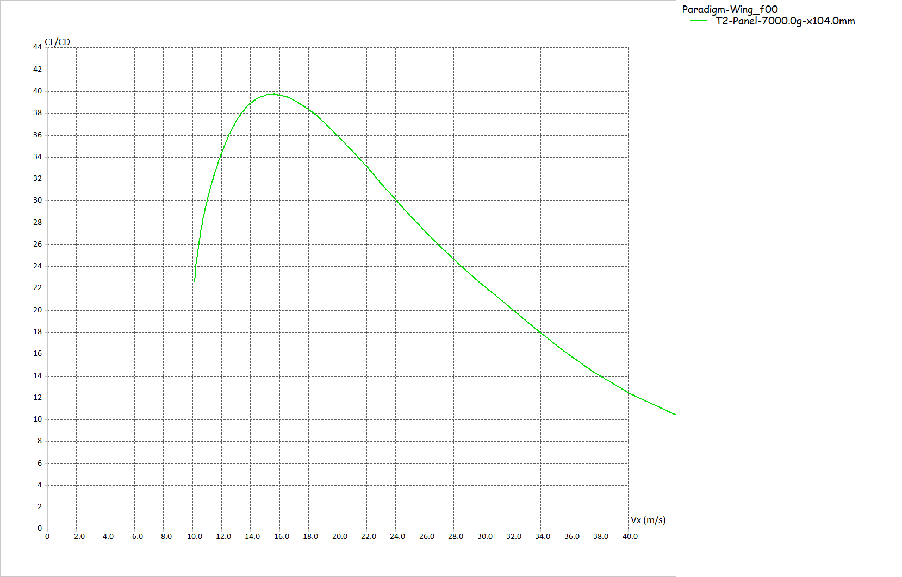
„Glide-Polar“ (L/D vs. Air Speed)
© Philip Kolb
Slide number 10

Slide 11
„Glide-Polar“ (L/D vs. Air Speed)
This curve reflects the glide ratios of our aircraft (in deed “only the wing”) at 7kg AUW and flaps in “Zero-degree-position”.
© Philip Kolb
Slide number 11

Slide 12
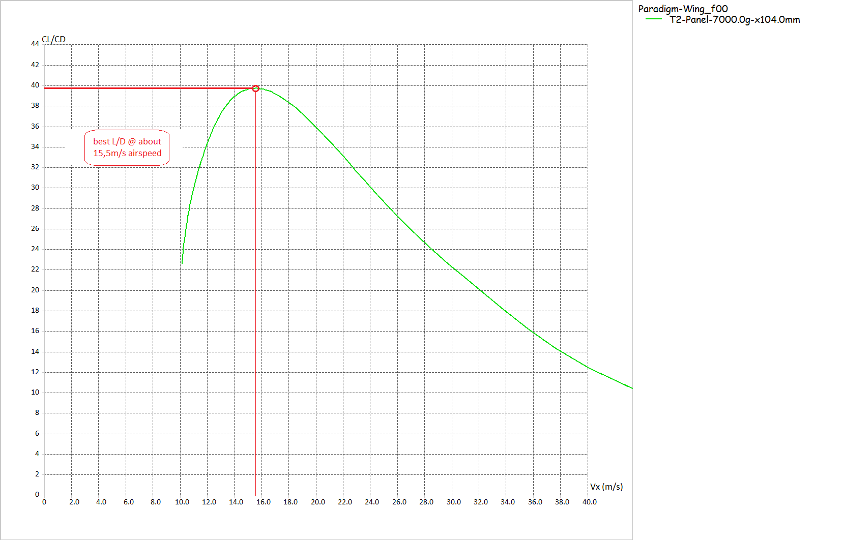
„Glide-Polar“ (L/D vs. Air Speed)
Maximum L/D about 39,74 @ 15,5m/s airspeed
…just like we`ve calculated before…
This curve reflects the glide ratios of our aircraft (in deed “only the wing”) at 7kg AUW and flaps in “Zero-degree-position”.
Going slower than that means, that L/D values drop. You might not be able to reach your goal anymore, but stay in the air longer!
Going faster than that means, that L/D values drop. But you can be “somewhere” earlier. …even if this might mean “on the ground”!
© Philip Kolb
Slide number 12

Slide 13
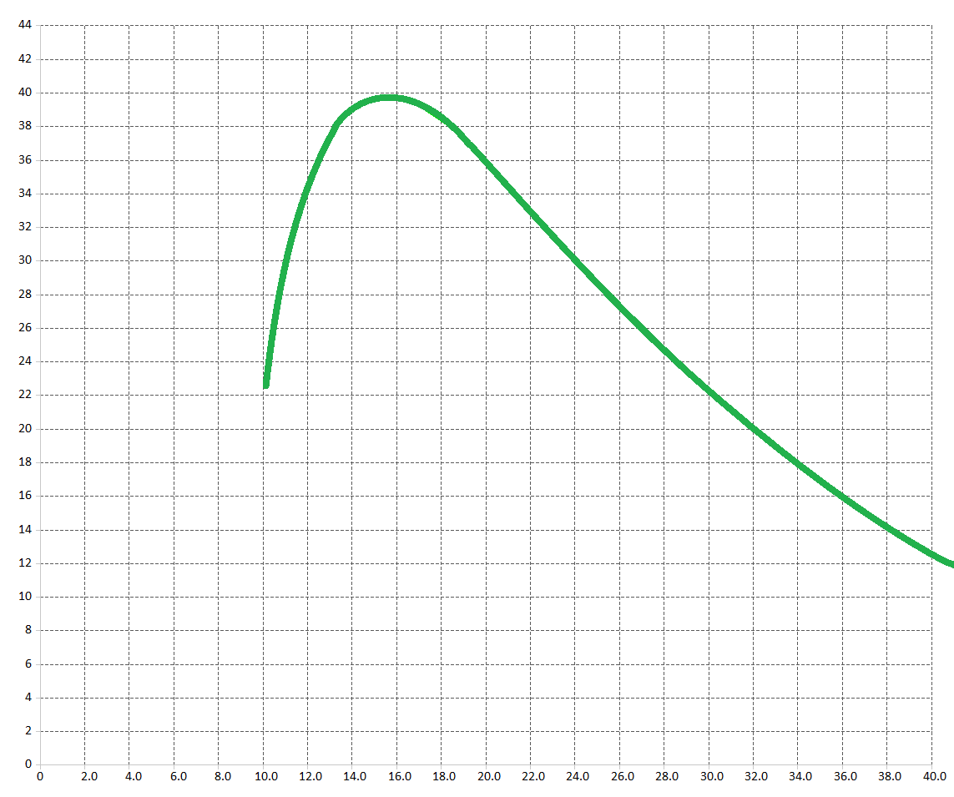
L/D as a determining number for our planes´ performance!
What else?
© Philip Kolb
Slide number 13

Slide 14
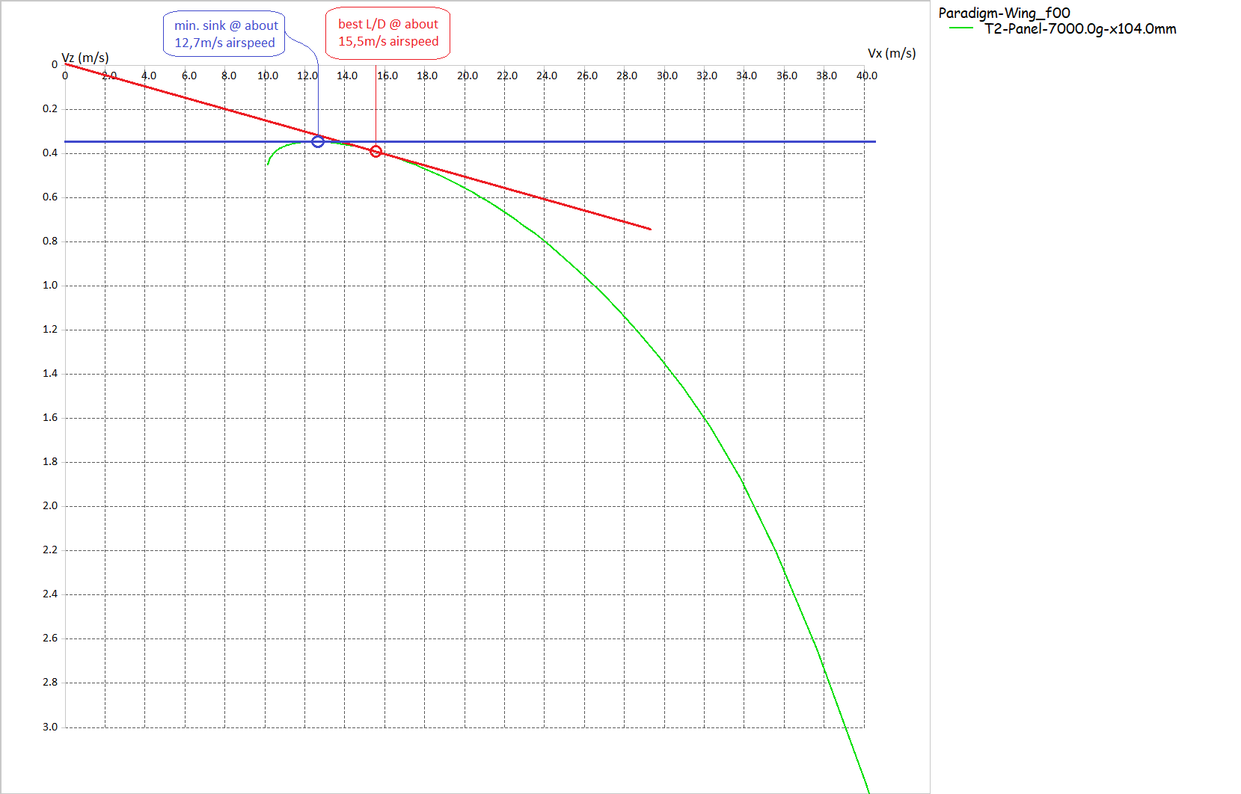
„Sink-Polar“ (Air Speed vs. Sink Speed)
Besides L/D we can measure performance of our gliders by it´s minimum sink rate. Both items are not necessarily the same!
In this case the minimum sink rate of this gliders wing at 7kg AUW with its flap in “zero position” is about 0,33m/s.
Flying at minimum sink will keep us aloft for the longest possible time in “dead air”. The air speed for min. sink in this case is 12,7m/s, which is considerably lower than the speed for best L/D.
© Philip Kolb
Slide number 14

Slide 15
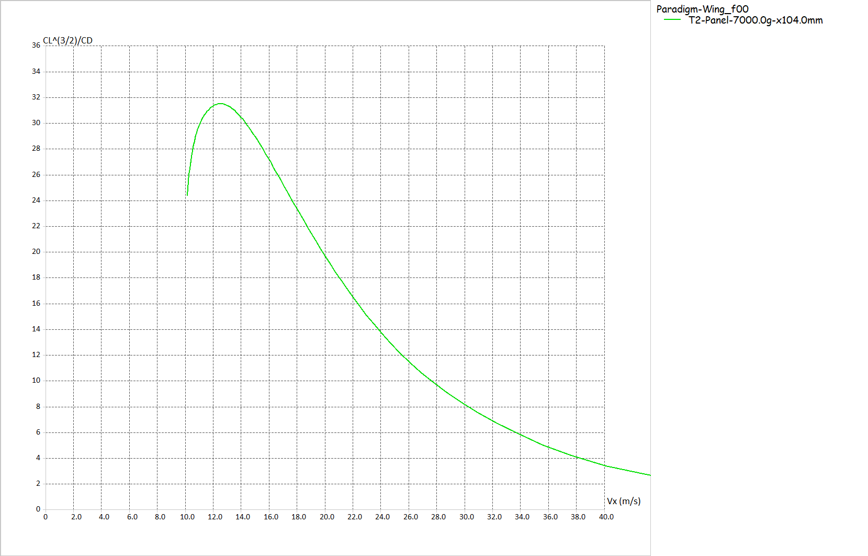
„Endurance-Polar“ (L^(3/2)/D vs. Air Speed)
© Philip Kolb
Slide number 15

Slide 16
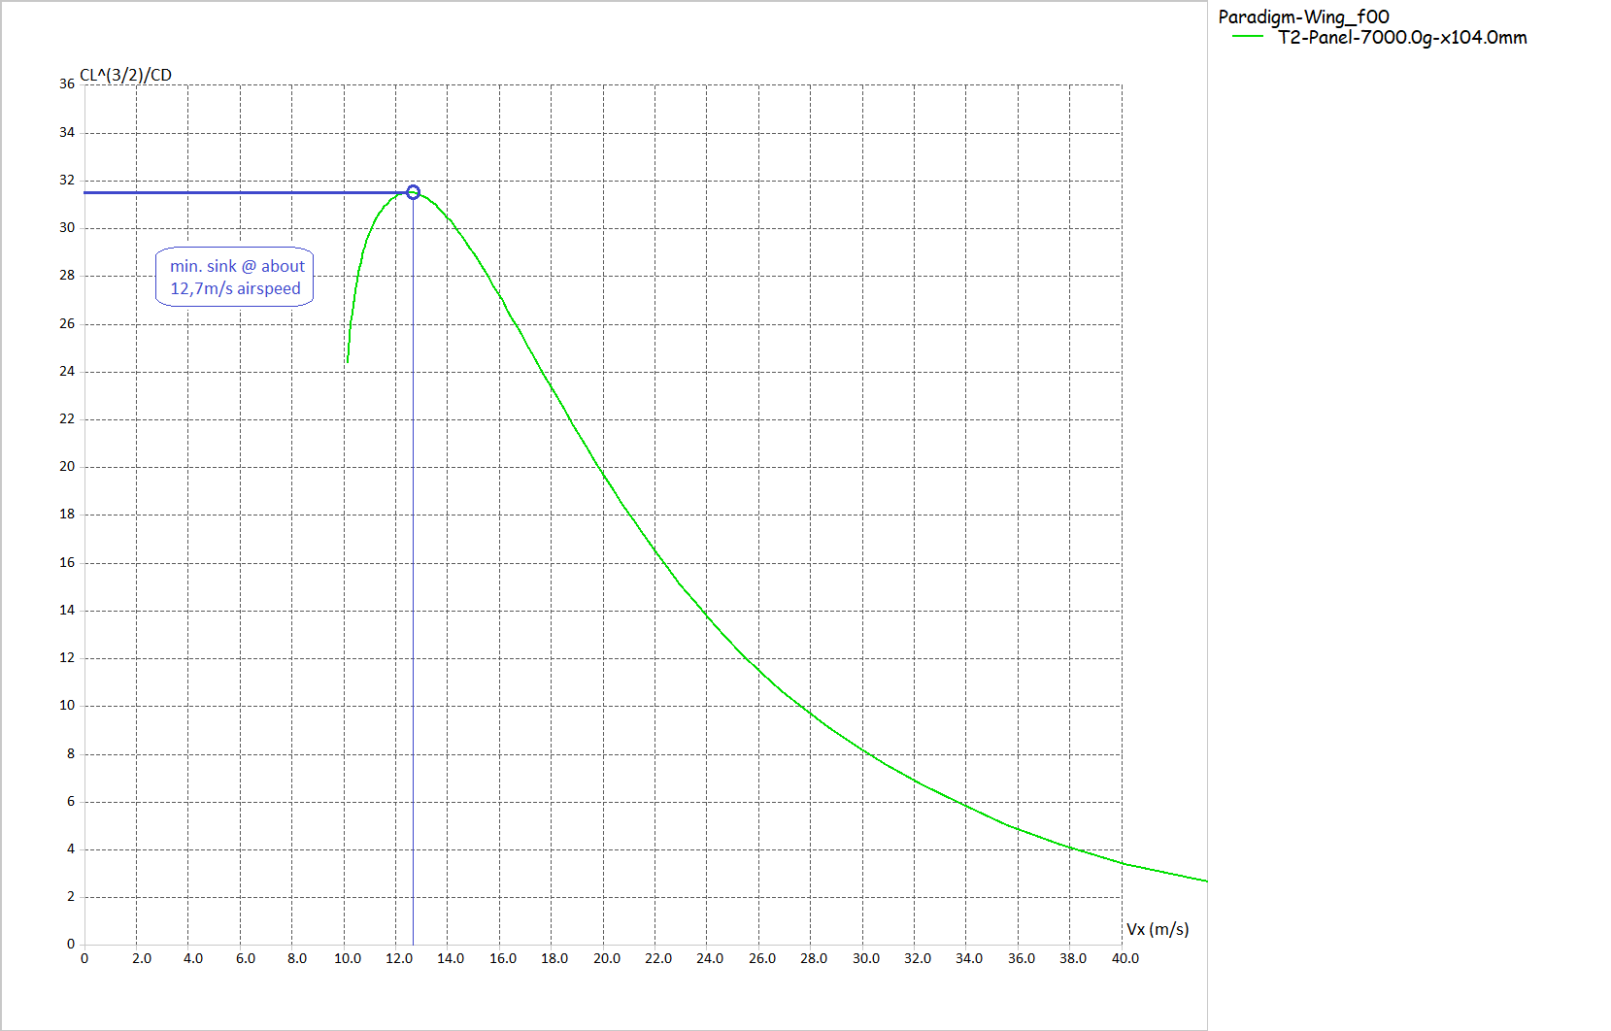
„Endurance-Polar“ (L^(3/2)/D vs. Air Speed)
As noticed from the Sink-Polars, the air speed for minimum sink is readable from this polar as well. It reaches its maximum endurance parameter at an airspeed of 12,7m/s.
© Philip Kolb
Slide number 16

Slide 17
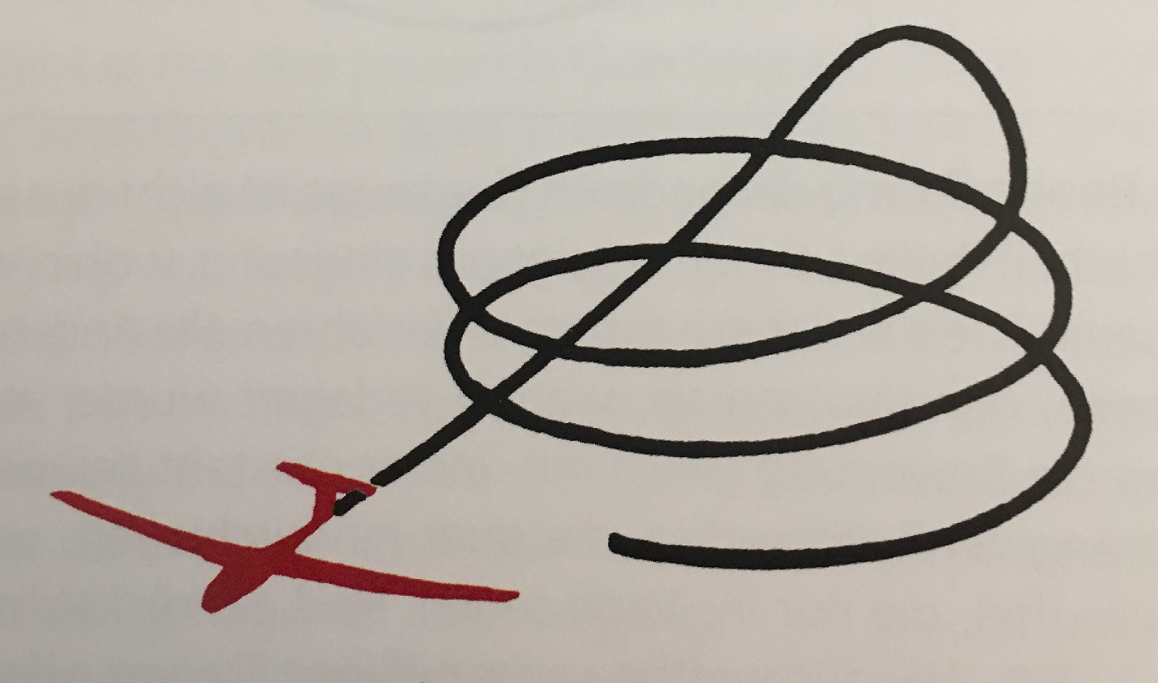
So how to tweak the setup of our aircraft
by considering these polars?!
© Philip Kolb
Slide number 17

Slide 18
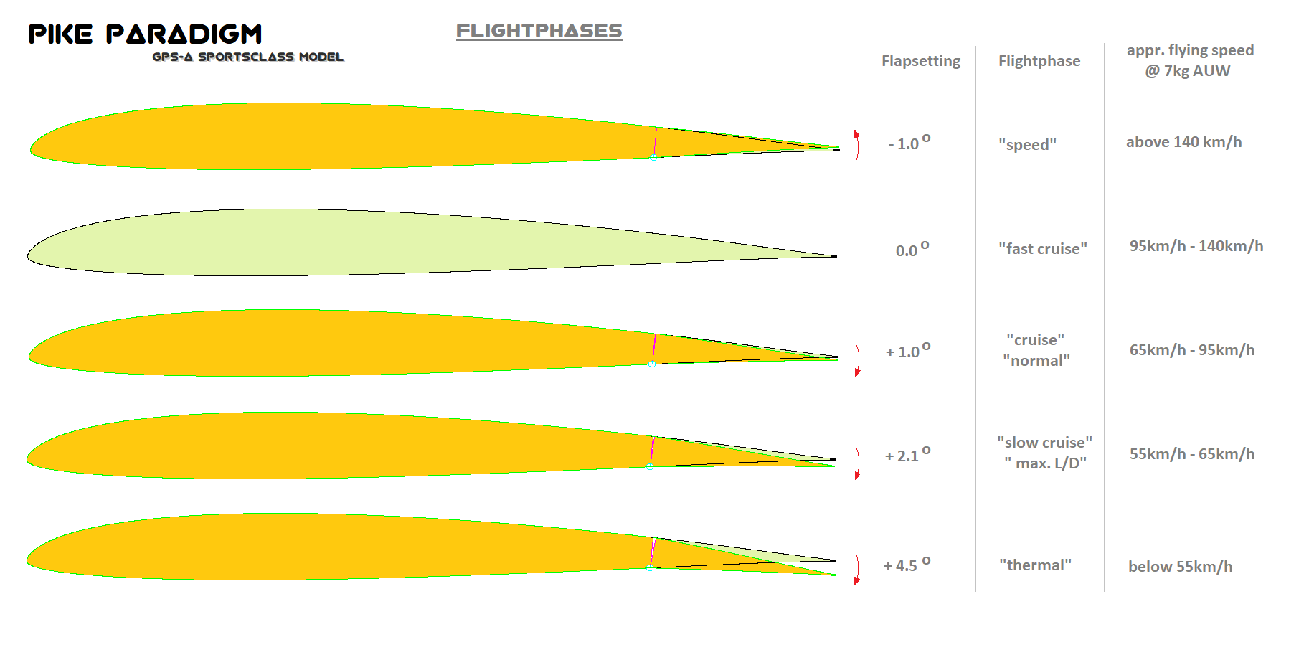
© Philip Kolb
Slide number 18

Slide 19
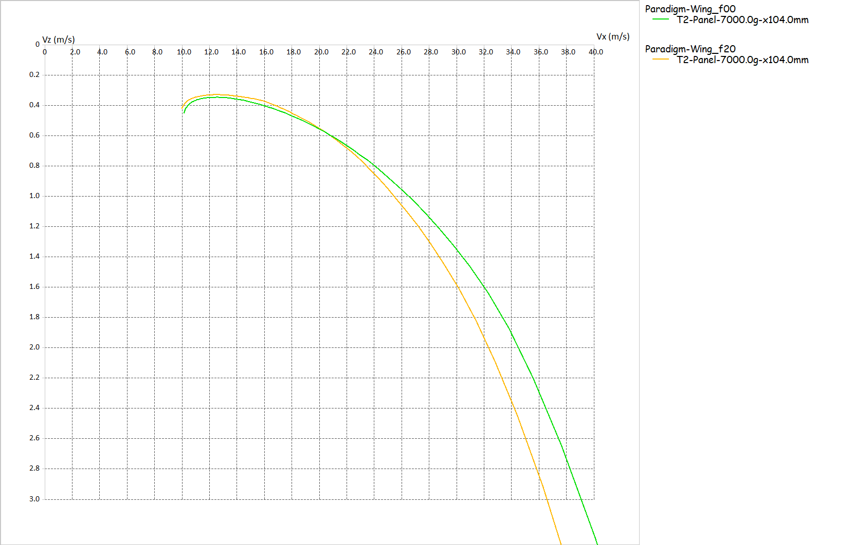
„Sink-Polar“ (Air Speed vs. Sink Speed)
Green polar: Aircrafts wing at 7kg AUW with flaps in “zero position” (f00)
Yellow polar: Aircrafts wing at 7kg AUW with flaps set to 2 degrees camber (f20)
© Philip Kolb
Slide number 19

Slide 20
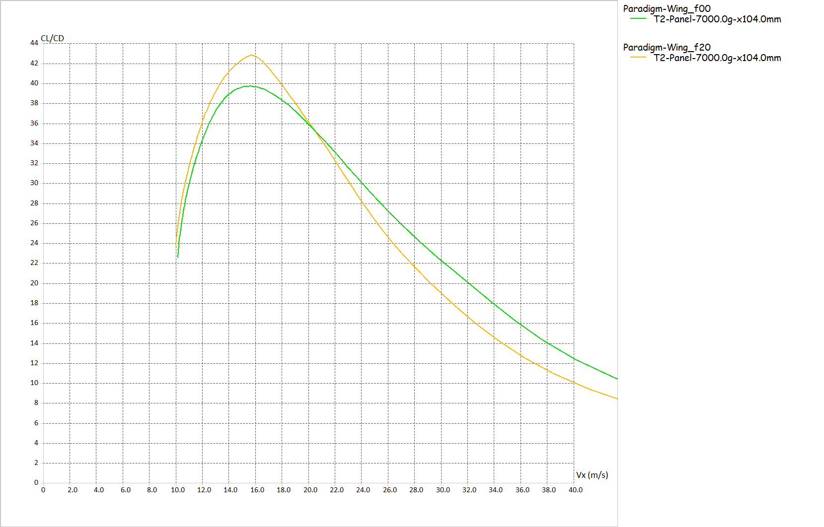
„Glide-Polar“ (L/D vs. Air Speed)
Slower than 20m/s → flaps +2 degrees
Green polar: Aircrafts wing at 7kg AUW with flaps in “zero position” (f00)
Faster than 20m/s → flaps 0 degrees
The pilot should switch flight-modes at about 20m/s air speed!
Yellow polar: Aircrafts wing at 7kg AUW with flaps set to 2 degrees camber (f20)
© Philip Kolb
Slide number 20

Slide 21
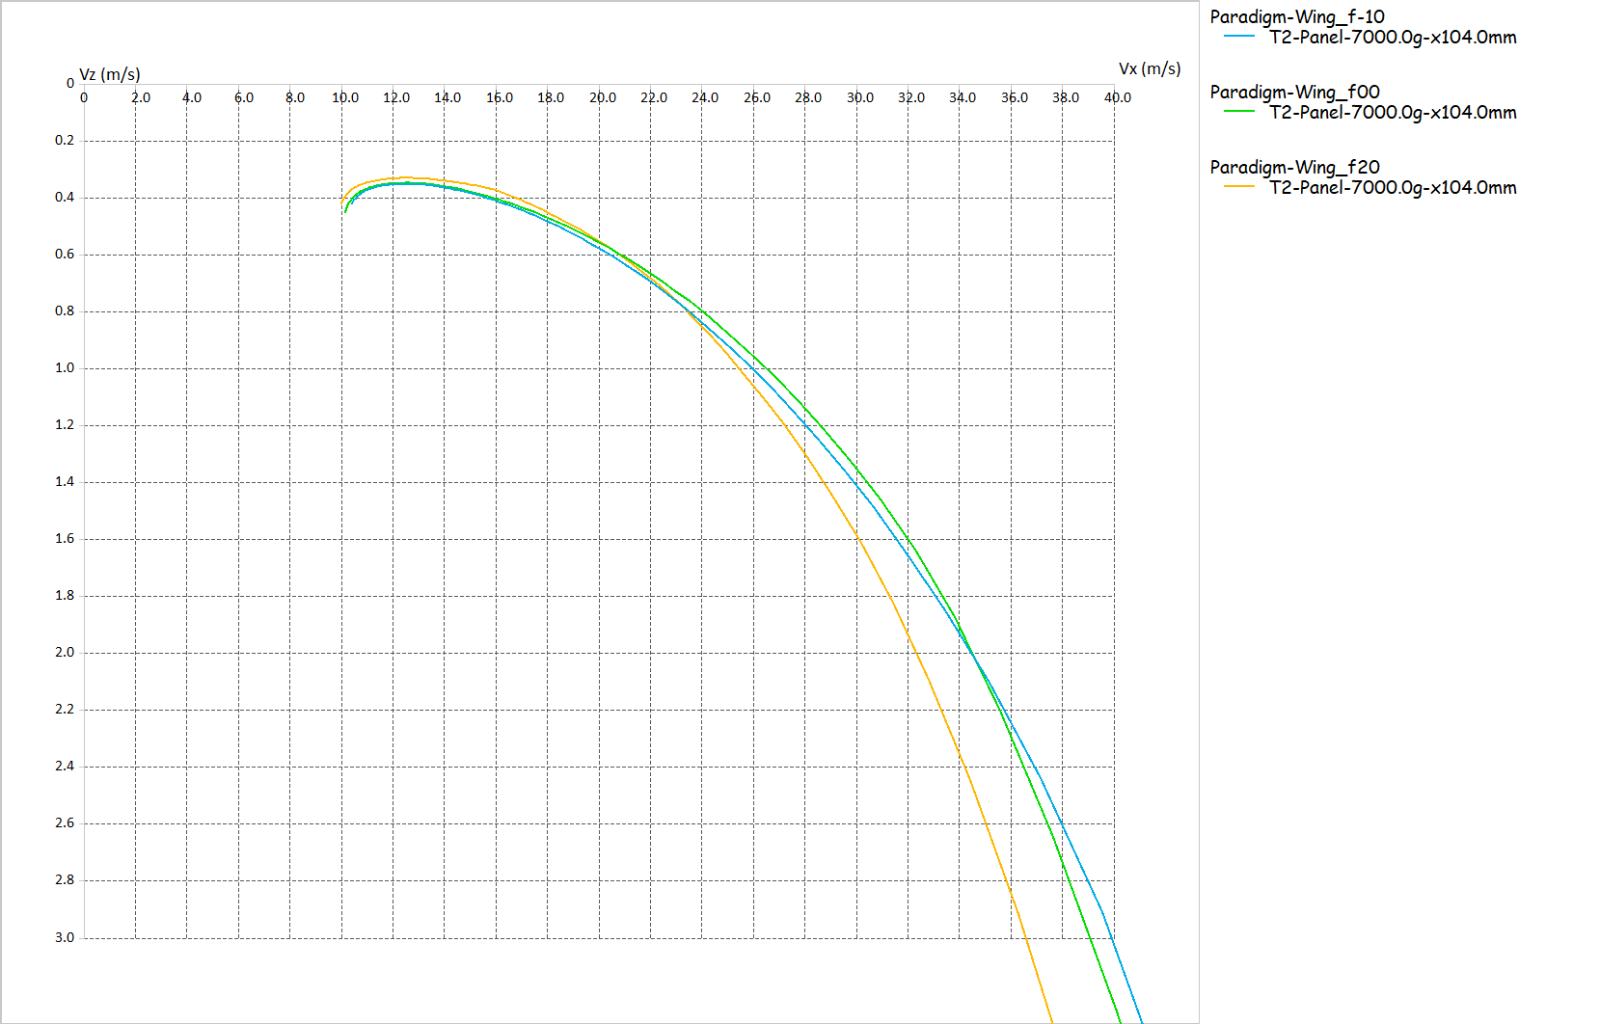
„Sink-Polar“ (Air Speed vs. Sink Speed)
Green polar: Aircrafts wing at 7kg AUW with flaps in “zero position” (f00)
Yellow polar: Aircrafts wing at 7kg AUW with flaps set to 2 degrees camber (f20)
Blue polar: Aircrafts wing at 7kg AUW with flaps set to -1 degrees reflex (f-10)
© Philip Kolb
Slide number 21

Slide 22
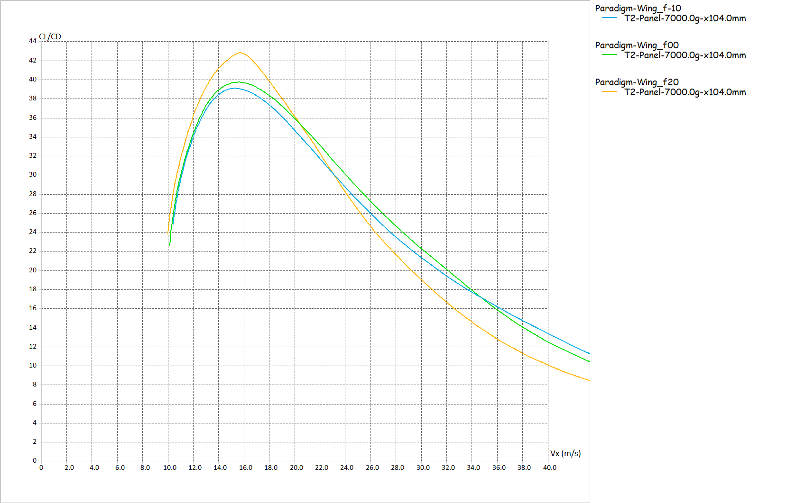
„Glide-Polar“ (L/D vs. Air Speed)
Green polar: Aircrafts wing at 7kg AUW with flaps in “zero position” (f00)
Yellow polar: Aircrafts wing at 7kg AUW with flaps set to 2 degrees camber (f20)
Now search the shifting points for the flight-mode switches!!!
Blue polar: Aircrafts wing at 7kg AUW with flaps set to -1 degrees reflex (f-10)
© Philip Kolb
Slide number 22

Slide 23
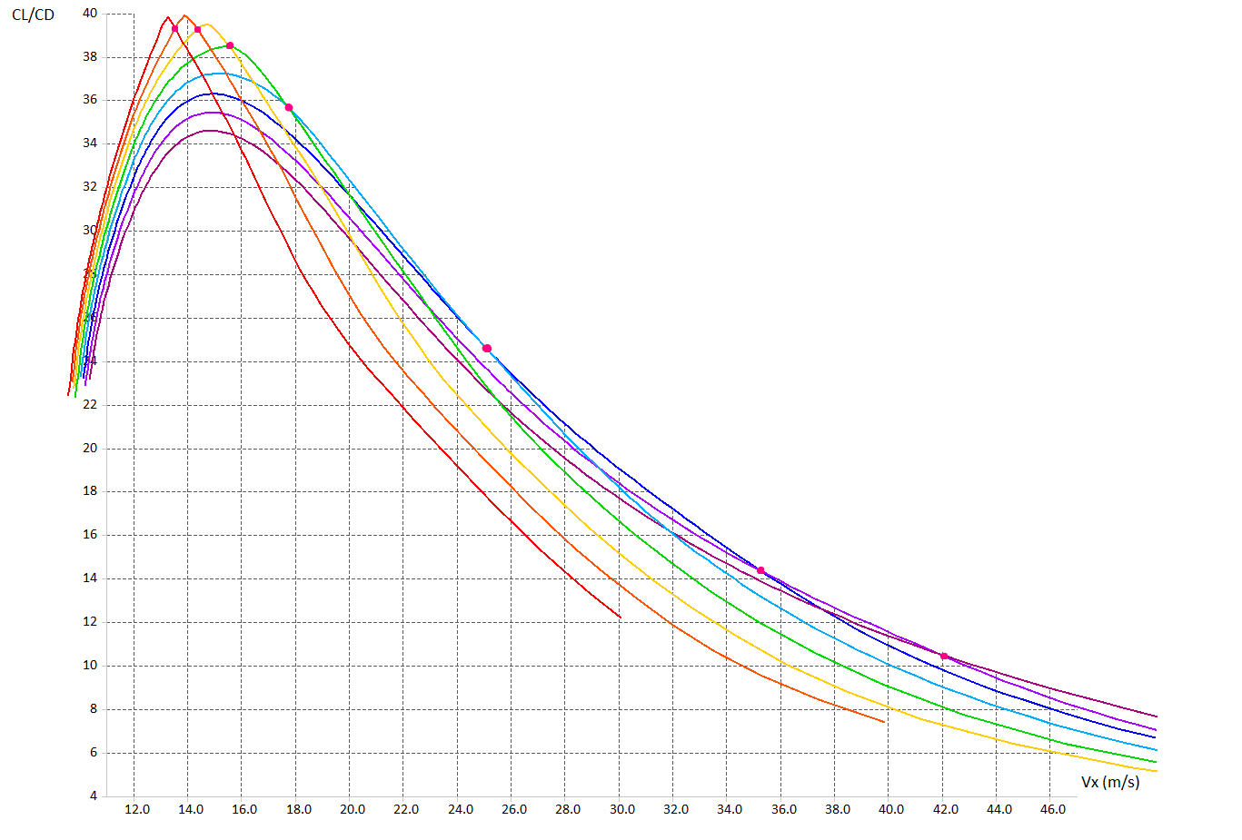
Camber / Reflex setup as a possible way to tweak our planes´ performance!
What else?
© Philip Kolb
Slide number 23

Slide 24
What else?
© Philip Kolb
Slide number 24

Slide 25
How to quantify the effects of ballast???
© Philip Kolb
Slide number 25

Slide 26
„Sink-Polar“ (Air Speed vs. Sink Speed)
Green polar: Aircrafts wing at 7kg AUW with flaps in “zero position” (f00)
What would happen if we add another 2kg of ballast to the “f00-glider” (green polar)???
Yellow polar: Aircrafts wing at 7kg AUW with flaps set to 2 degrees camber (f20)
Blue polar: Aircrafts wing at 7kg AUW with flaps set to -1 degrees reflex (f-10)
© Philip Kolb
Slide number 26

Slide 27
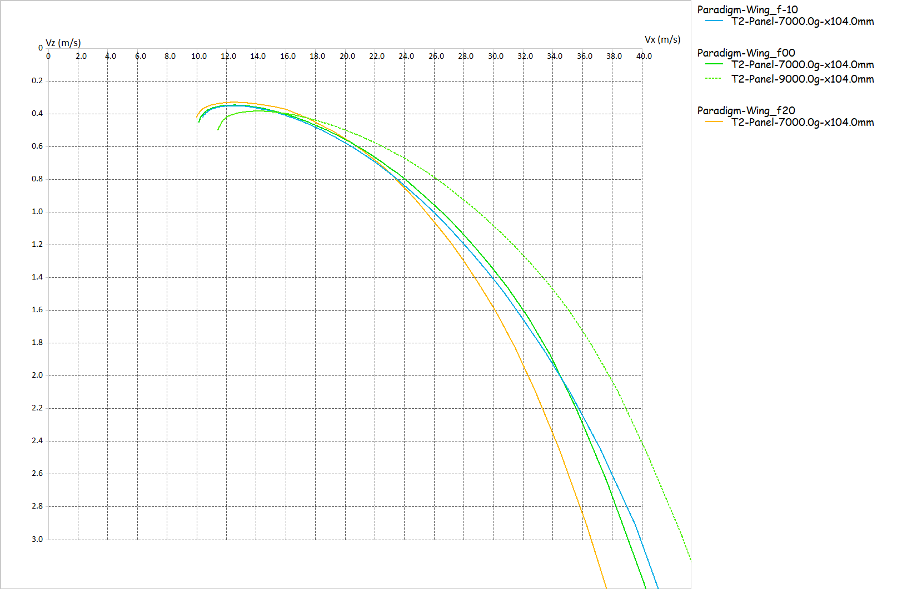
„Sink-Polar“ (Air Speed vs. Sink Speed)
Green polar: Aircrafts wing at 7kg AUW with flaps in “zero position” (f00)
What would happen if we add another 2kg of ballast to the “f00-glider” (green polar)???
Yellow polar: Aircrafts wing at 7kg AUW with flaps set to 2 degrees camber (f20)
Blue polar: Aircrafts wing at 7kg AUW with flaps set to -1 degrees reflex (f-10)
© Philip Kolb
Slide number 27

Slide 28
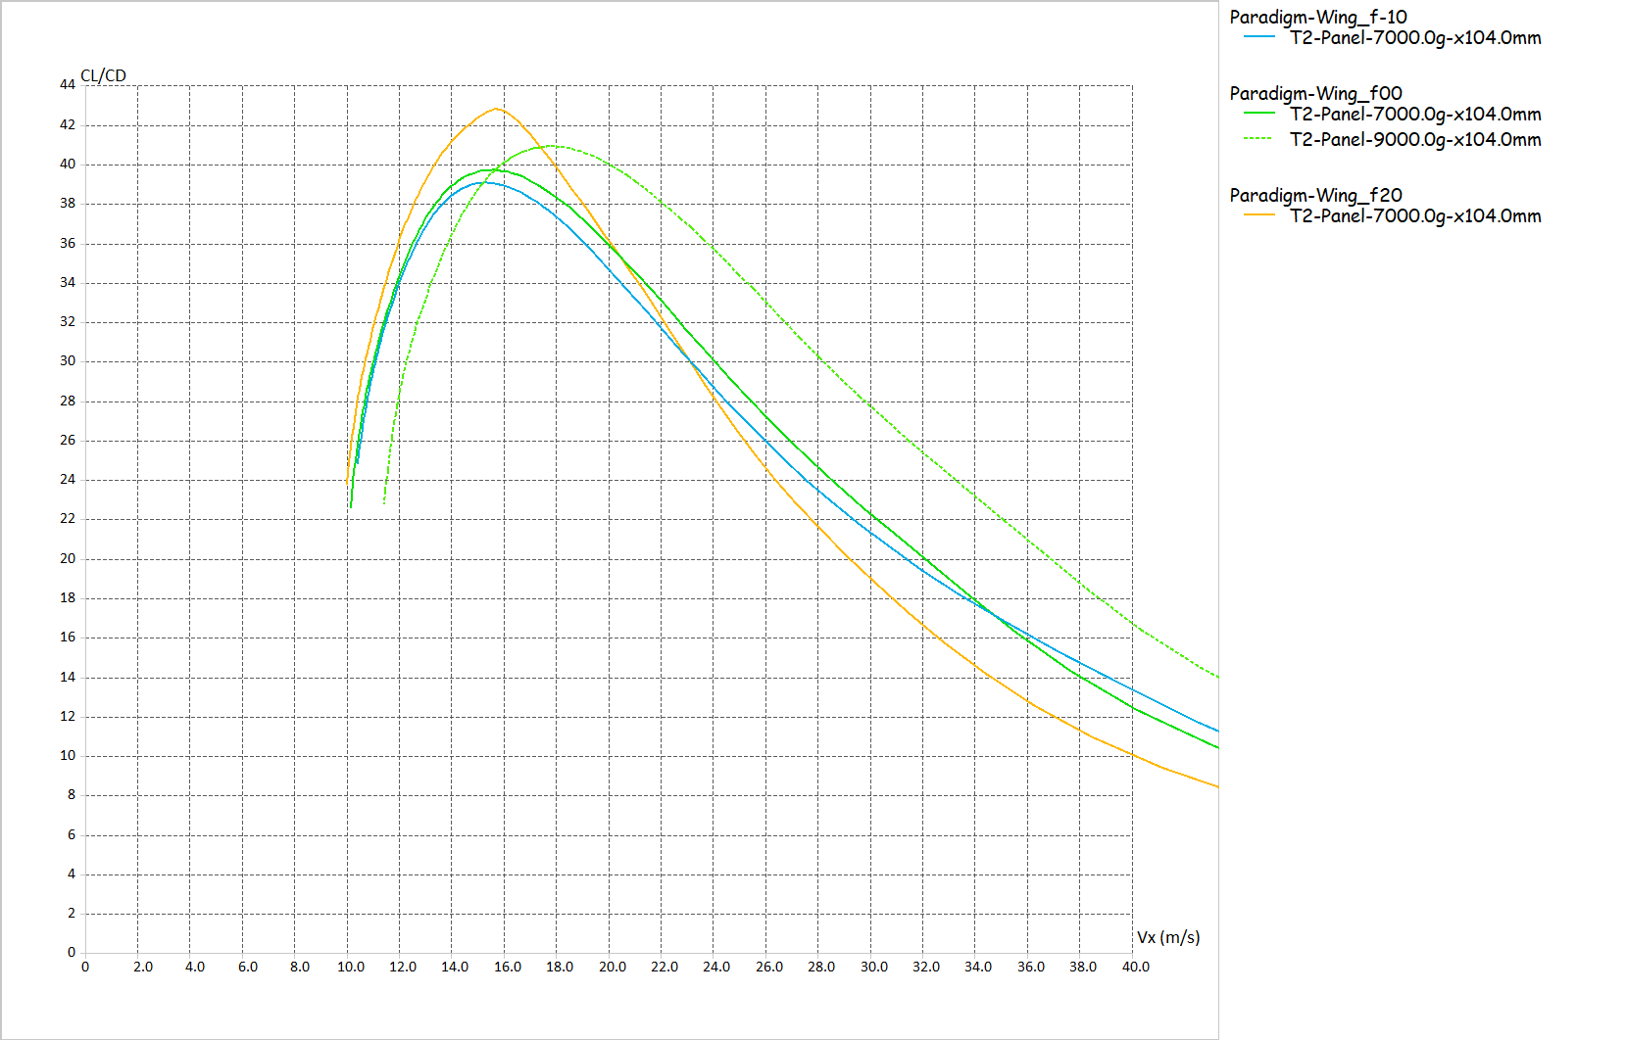
„Glide-Polar“ (L/D vs. Air Speed)
Adding ballast primarily is shifting our performance-polars to the right towards higher L/D-numbers at faster air speeds.
Green polar: Aircrafts wing at 7kg AUW with flaps in “zero position” (f00)
What would happen if we add another 2kg of ballast to the “f00-glider” (green polar)???
Yellow polar: Aircrafts wing at 7kg AUW with flaps set to 2 degrees camber (f20)
At the same time the stall speed and minimum sink is increasing which can harm performance at slow air speeds.
Blue polar: Aircrafts wing at 7kg AUW with flaps set to -1 degrees reflex (f-10)
© Philip Kolb
Slide number 28

Slide 29
Before trying to meticulously set Camber and Reflex the perfect way, try and think about ballasting first!
What else?
© Philip Kolb
Slide number 29

Slide 30
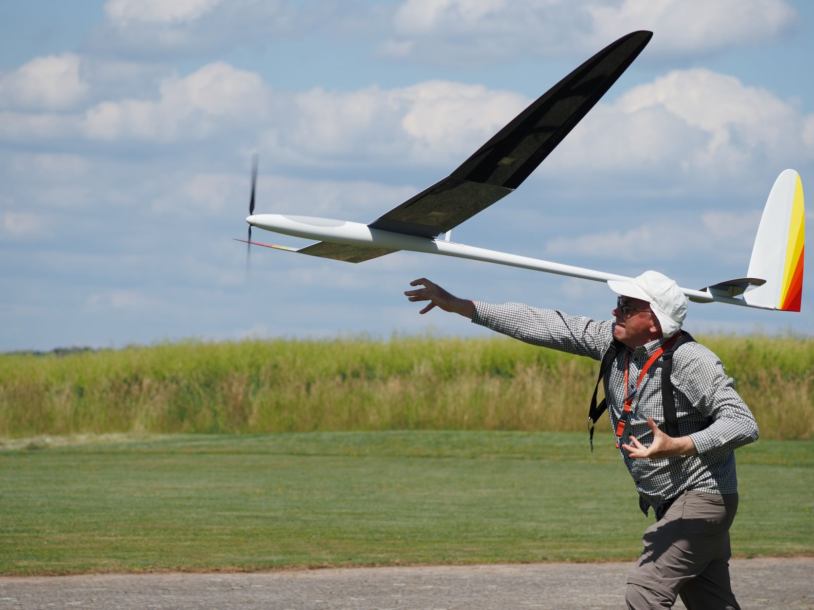
Enough for now!!!
Thank you for your attention!
Let this sink in …..we`ll be back with the basics of “MacCready – Flying” soon.
Any Questions?
© Philip Kolb
Slide number 30

